Slide 1
Static Analysis and Program Safety in C++: Making it real
Sunny Chatterjee

Slide 2
Welcome to CppCon 2021!
Visit our booth in the main hall
Meet the Microsoft C++ team
Ask any questions
Discuss the latest announcements
Take our survey https://aka.ms/cppcon

Slide 3
Contributors

Slide 4
This talk
C++ code safety: Why it matters
What is Static Analysis
Integrating safety checks with Visual Studio and GitHub
Static Analysis in action
Where we are
What’s next
Join the fun!

Slide 5
C++ code safety: Why it matters
“Complete type-and-resource safety have been an ideal (aim) of C++ from very early on (1979)” – Bjarne Stroustrup
Great customer experiences start with quality
Crashes and hangs
Poor performance
Security vulnerabilities
Need more than language and compiler
Judicious programming rules (C++ Core Guidelines)
Static Analysis
Guideline Support Library (GSL)

Slide 6
What is Static Analysis
Finds bugs in programs at compile time
Systematically applies clever techniques to look for bug patterns in source code
Complements traditional testing techniques and runtime checks
A bug which costs $1 to fix on the programmer’s desktop costs $100 to fix once it is incorporated into a complete program, and many thousands of dollars if it is identified only after the software has been deployed in the field.
– Building a better bug-trap | The Economist

Slide 7
Safety checks Visual Studio and GitHub

Slide 8
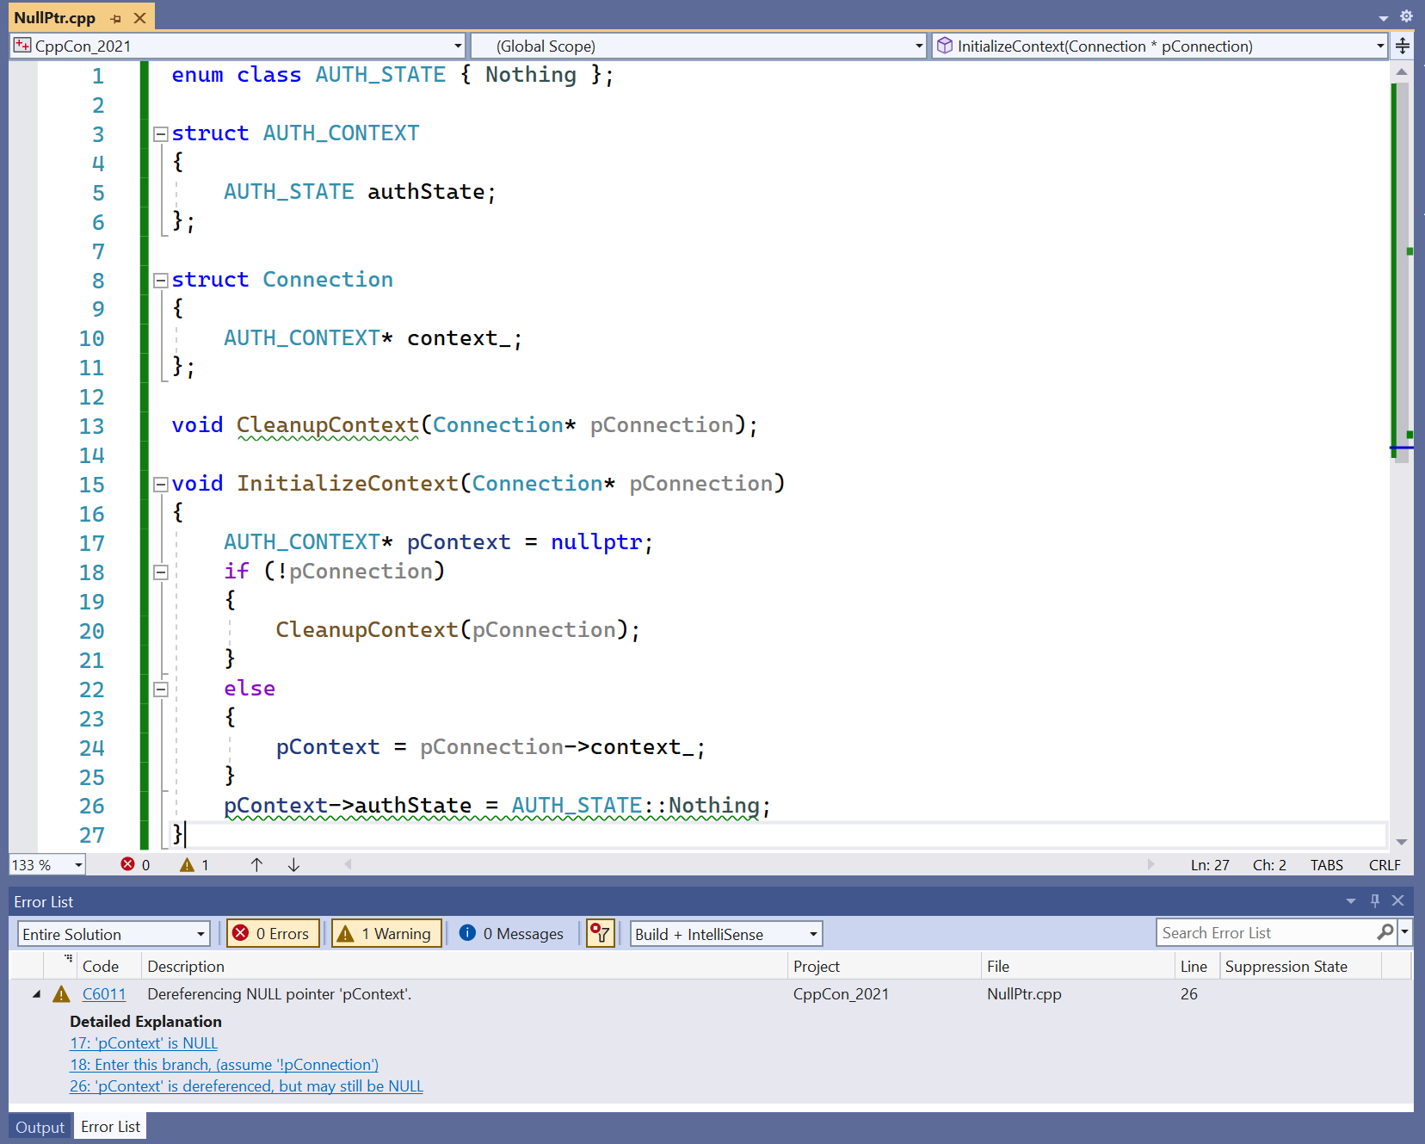
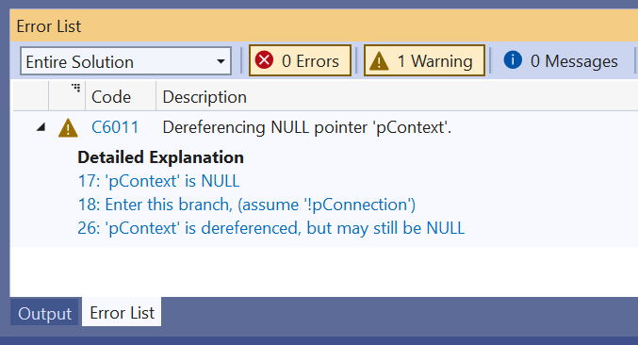
Defects should show up in almost real time
Defects should be easily understandable

Slide 9
GitHub Integration
Announcing a publicly available GitHub Action for C++ community to run code safety checks and view results in GitHub Visualizer.
Microsoft C++ Code Analysis with GitHub Actions - C++ Team Blog
Code Scanning in GitHub
GitHub Action makes it easy for integrating analysis tools producing standard SARIF 2.1 format in the project
Other actions from Microsoft: DevSkim, PSScriptAnalyzer

Slide 10
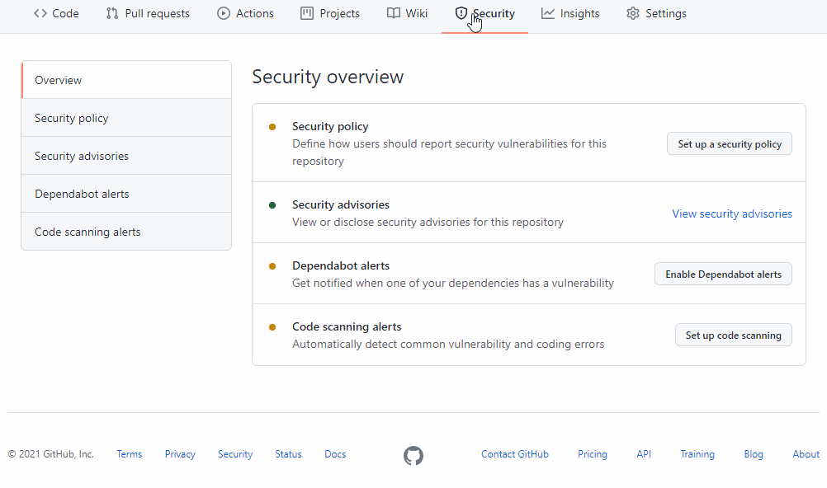
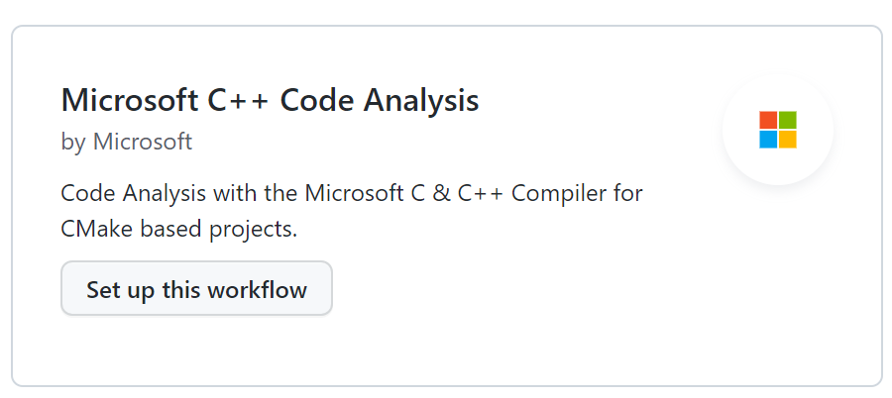

Slide 11
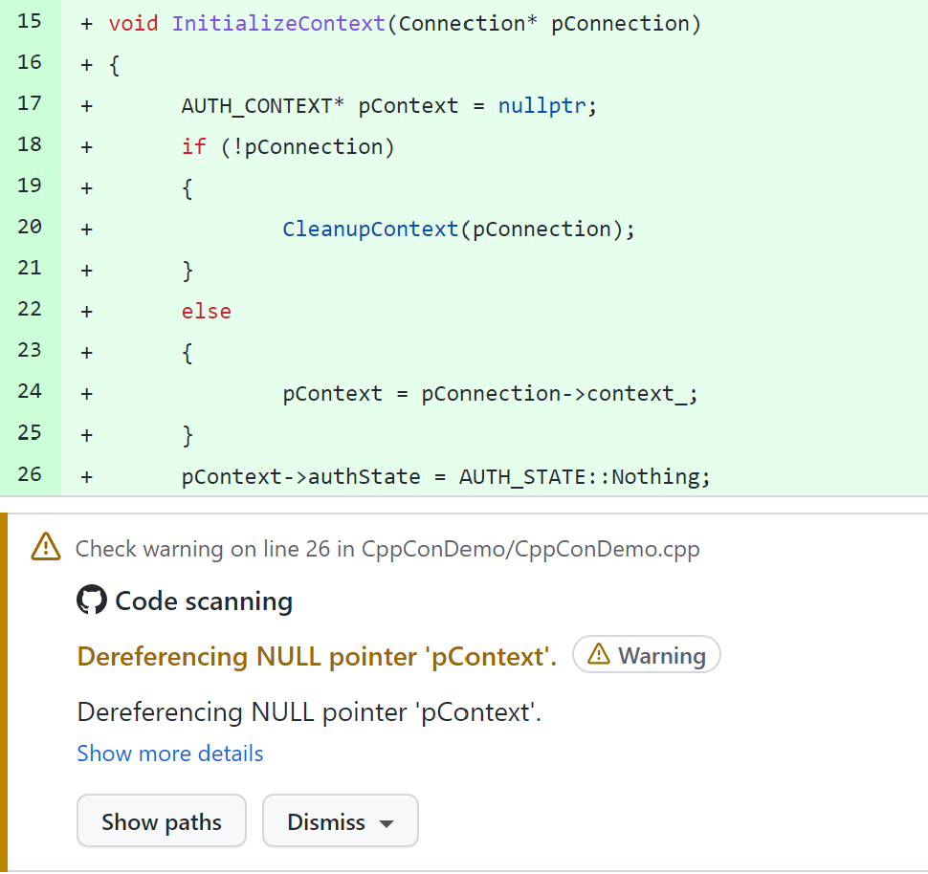

Slide 12
Ideal way to “shift left” in GitHub
If you are the maintainer of an OSS project, give it a try!
Code scanning is free for all public repositories via GitHub
Automates static analysis runs in the PR workflow
Surfaces results to engineers working on the code before merge
For private repositories, check out GitHub Advanced Security offering

Slide 13
Static Analysis in action

Slide 14
union X
{
void* pv;
Y* py;
};
extern char* string_from_stream();
void foo(bool condition)
{
X* px = new X();
if (condition)
{
auto pw = string_from_stream();
px->pv = pw; // string pointer assigned
}
else
{
px->py = new Y();
}
// Further down in code
px->py->f();
}
warning C26476: Expression/symbol 'px' uses a naked union 'union X' with multiple type pointers: Use variant instead (type.7)
Lint style checks to the rescue!
Game over, we call attacker-controlled string pointer!

Slide 15
Type confusion attack
Unions with multiple type pointers vulnerable to type confusion attack
Type depends on external conditions
Easy to loose control over pointer values of class or struct member
Common in production software
Mitigation Strategy
Unions with multiple pointers inside should use std::variant
Prevents replicating new code like this
Supported by C++ Core Guidelines rule type.7
Easy check to implement for a linter

Slide 16
extern size_t GetIndex(int* buf, int bufSize);
int FetchElement(int* buf, int bufSize)
{
const auto index = GetIndex(buf, bufSize);
return buf[index];
}
Warning C26429: Symbol ‘buf’ is never tested for null-ness, it can be marked as not_null
Simple bugs, but difficult to track down later
buf[index] → *(buf + index)
IsNull(buf) → Unknown
*(buf + index) → `buf` must be non-null

Slide 17
Lint style checks
Lint style checks finds defects quickly
Cheap to locate and fix
Checks built on syntax or simple “flow” analysis
Many successful “lint” checks available
Happy customers!

Slide 18
Scaling Lint-style checks
Need to analyze across function boundaries
Inter-procedural analysis: Whole program analysis
Starts with leaf level functions, constructs function properties, propagates properties up the call chain
Slow – best suited for the outer loop
Great for specific problem domains like “use after free”
Intra-procedural or local analysis: Analyze each function in isolation
Cannot see across function boundaries
Infers function call semantics from types, type extensions, modifiers, heuristics, and source annotations
Fast– best suited for the inner loop
Finds issues across a wide domain

Slide 19
Warning C26429: Symbol ‘buf’ is never tested for null-ness, it can be marked as not_null
extern size_t GetIndex(int* buf, int bufSize);
int FetchElement(int* buf, int bufSize)
{
const auto index = GetIndex(buf, bufSize);
return buf[index];
}
Guards against null
int FetchElement(int* buf, int bufSize)
{
if (buf == nullptr)
return -1;
const auto index = GetIndex(buf, bufSize);
return buf[index];
}
Cheap to locate and fix!

Slide 20
Warning C26707*: Possibly incorrect single element annotation on buffer. Potential read overflow using expression ‘buf[index]’
extern size_t GetIndex(int* buf, int bufSize);
int FetchElement(int* buf, int bufSize)
{
if (buf == nullptr)
return -1;
const auto index = GetIndex(buf, bufSize);
return buf[index];
}
What is the relationship between ‘buf and ‘bufSize’?
Static Analysis assumes ‘buf’ size to be 1 element.
How to express buffer size in C++?
*Not publicly available yet
Wait….what???

Slide 21
Warning C26019: Potential read overflow using expression ‘buf[index]’. Buffer access in apparently unbounded by buffer size. In particular: result.GetIndex`9a is not constrained by bufSize`5.
#include <sal.h>
extern size_t GetIndex(int* buf, int bufSize);
int FetchElement(_In_reads_(bufSize) int* buf, int bufSize)
{
if (buf == nullptr)
return -1;
const auto index = GetIndex(buf, bufSize);
return buf[index];
}
Annotations to the rescue
Suddenly, we can catch real buffer overruns
*Not publicly available yet
bufSize`5
result.GetIndex`9a
Do I have to learn a new annotation language?

Slide 22
Annotation advantages
Formalizes code documentation
Improves Static Analysis
Improves API design
Provides lasting and incremental ROI
Annotation disadvantages
Non-portable
Quickly explodes in source code
Not the ultimate source of truth
As good as the tools

Slide 23
#include <gsl\\gsl>
extern size_t GetIndex(gsl::span<int> buf);
int FetchElement(gsl::span<int> buf)
{
const auto index = GetIndex(buf);
if (index < buf.size())
return buf[index];
return -1;
}
Types and type extensions are good!
Portable
Checked by the compiler
Runtime checks become possible
C++20 take: Range checked at runtime. Without the if-guard, we also warn statically
Looks good!

Slide 24
PDB_RECORD SigWireRead(
IN OUT PPARSE_RECORD pRR, // ptr to database record
IN OUT PDNS_MSGINFO pMsg, // message being read
IN PCSTR pchData, // ptr to RR data field
IN WORD wLength // length of data field
)
{
PDB_RECORD prr;
PCSTR pch;
intptr_t sigLength;
COUNT_NAME nameSigner;
// Allocate the RR
prr = RR_Allocate(
SIZEOF_SIG_FIXED_DATA +
COUNT_NAME_SIZE(&nameSigner) +
sigLength);
// Copy signature.
RtlCopyMemory(
(PBYTE)&prr->Data.SIG.nameSigner +
DBASE_NAME_SIZE(&prr->Data.SIG.nameSigner),
pch,
sigLength);
return prr;
}
Heap overflow in DNS server caused by integer truncation!
Sum may overflow, potentially causing ‘prr’ to be ~0 bytes at the memcpy.
Arithmetic overflows aren’t fun!

Slide 25
Warning C26138: global_m is held while yielding.
std::mutex global_m;
_Guarded_by_(global_m) int var = 0;
generator<int> mutex_acquiring_generator() {
global_m.lock();
++var;
co_yield 1;
global_m.unlock();
}
Cool, deadlocks are hard to debug!

Slide 26
Static Analysis Framework
Handle callbacks of interest
Detect and report some class of defect
Parses a file and ensures it has valid syntax
Produces ASTs that represent source code
Load and unload plugins
Invoke callbacks on each plugin as decls and defns are parsed
Emit defects
Process ASTs to simulate function execution via CFGs
Invoke callbacks on each extension as simulation proceeds
Extension1
C/C++ Front End
PREfast
EspXEngine
Handle callbacks of interest
Detect and report some class of defect
Extension2
Symbolic state tracking
Fast constraint solver
Alias Analysis
Loop widening
CppCon 2021: Finding Bugs Using Path-Sensitive Static Analysis by Gabor Horvath

Slide 27
Where we are
Static Analysis is in use at Microsoft for nearly two decades
Built on top of 10+ years of research
Validated millions of lines of C++ code in production software
Available in all editions of Visual Studio and GitHub Action
Static Analysis finds bugs, it is free, and you should use it!
Go save some $$$ ☺

Slide 28
What’s next?
C++ safety checks: Close the gap
Buffer overruns
Null pointer dereferences
Arithmetic overflow in allocators
Memory leaks
Uninit (std::optional exploit)
Concurrency
Support new language features
Accurate results
Fast speed
Make analyzer more understandable
Customize results
Make Static Analysis universally available
Coroutines
Modules
Minimize false positives
Code contracts ☺
Key Events
/external
Rulesets
Defaults
Filtering
Static Analysis runs are 45% faster in OS repo
Lifetimes

Slide 29
Join the fun!
Contribute – checks, bug reports, fixes, tests, ideas
Reach out to us via Visual Studio Feedback for feedback and suggestions
Resources
Microsoft C++ Code Analysis with GitHub Actions
C++ Team Blog (microsoft.com)
Code analysis for C/C++ overview
Clang-Tidy
isocpp/CppCoreGuidelines
microsoft/GSL
Static Analysis Results Interchange Format (SARIF) (github.com)

Slide 30
Enjoy the rest of the conference!
Visit our booth in the main hall
Meet the Microsoft C++ team
Ask any questions
Discuss the latest announcements
Take our survey https://aka.ms/cppcon

Slide 31
Our Sessions
Monday 25th
Implementing C++ Modules: Lessons Learned, Lessons Abandoned – Cameron DaCamara & Gabriel Dos Reis
Tuesday 26th
Documentation in The Era of Concepts and Ranges – Sy Brand & Christopher Di Bella (Google)
Static Analysis and Program Safety in C++: Making it Real – Sunny Chatterjee
In-memory and Persistent Representations of C++ – Gabriel Dos Reis (online 27th)
Extending and Simplifying C++: Thoughts on pattern Matching using `is` and `as – Herb Sutter
Wednesday 27th
What's New in Visual Studio: 64-bit IDE, C++20, WSL 2, and more – Sy Brand & Marian Luparu
Thursday 28th
C++20’s <chrono> Calendars and Time Zones in MSVC – Miya Natsuhara
An Editor Can Do That? Debugging Assembly Language and GPU Kernels in Visual Studio Code – Julia Reid
Why does std::format do that? – Charlie Barto
Finding bugs using path-sensitive static analysis – Gabor Horvath (online 29th)

