Slide 1
Architecting Multithreaded Robotics Applications in C++
Arian Ajdari and Jasmin Jahic

Slide 2
Developing impactful software requires more than writing fast, concise, and correct code «

Slide 3
Content
Setting up Context
Software Architecture
Software Architecting
Software Architect
C++ and Robotics Applications
Explaining the Problem
Software Stack
Hardware Stack
Arising Confusion
Reformulation of Problem by combining Software Architecting, Robotics Engineering and Multi-Threading
Challenges faced by Robotics Engineers
ROS (C++) and Multi-Threading
LLAMBA as a solution
Important Parameters
Conceptual Solution
Implementation
Evaluation
Evolution

Slide 4
Definition: Software Architecture
Software Architecture in a nutshell presents:
A blueprint
Organisation of the software systems
A process which leads from idea, to realization of the software, and its maintenance

Slide 5
Definition: Software Architecting
Idea
Customer comes up with an idea
System Requirements
Idea is formalized through system requirements
Architecture Drivers
Most important system requirements influence our system
Architecture Solutions
Decisions made to realize the system
Implementation
Implementation of system which targetted technologies
Maintenance
Ironing out the bugs, and general improvements

Slide 6
Software Architect
Testers
Business
Developers
Customer
Project Manager
Software Architect
Marketing
HR
Operation

Slide 7
C++ and Robotics Applications
Robotics Industry presents an umbrella of more than 500 companies that make robots and robotics applications covering many fields.
Software that usually runs robotics applications has facilities for low-level access. Suitable candidates are C/C++.
Many frameworks have emerged to support the development of robotics applications. One of the most prominent one is ROS2 (Robot Operating System).
ROS2 is open source
Based on publisher/subscriber pattern
Has support for different middlewares facilitating communication
Targets newer C++ versions

Slide 8
Problem
Robotics engineers would like to build an application that does SLAM (Simultaneous Localization and Mapping)
Robotics enginners understand hardware, therefore know that multi-threading can be utilized for performance benefits
However, correct utilization of multi-threading is a hard process and error-prone. Therefore, they come to conclusion that multi-threading is a significant architectural decisions and therefore rely on the software architect to correctly apply multi-threading.

Slide 9
Stack
Software Stack
Operating System
Hardware

Slide 10
Hardware
Main Memory
L3
L2
L2
L2
L2
L1
L1
L1
L1
Core 0
Core 1
Core 2
Core 3

Slide 11
Operating System
Scheduler
Synchronization Mechanisms
Heap
Stack
Stack
Stack
Stack
BSS
BSS
BSS
BSS
Data
Data
Data
Data
Text
Text
Text
Text
P1
P2
P3
P4

Slide 12
Software Stack
Publishers
Subscribers
Actions
Services
Callback Group
Timers
Executor
RCLCPP
RMW
P4
Threading Library
C++

Slide 13
Confusing
In order to utilize multi-threading in robotics application
A fine knowledge of C++ is required
A fine knowledge of the whole software and hardware stack
A fine knowledge of how multi-threading is handled
P4

Slide 14
Reformulation of the Problem
While Robotics Engineers are good at modeling robotics applications, they struggle:
To understand Software Engineering related concepts
To understand low-level multi-threading concepts
Understand C++ on low-level and its relationship to hardware
Furthermore, C++:
Specific parallelization library tailored to ROS2 requirements
Pthread is too low-level and thread library from C++ is too abstract for our needs
Architecting Robotics Applications is challenging:
Many different aspects of software development inter-mingle
Development stack includes both hardware and software
Robotics Engineers specialize in their own sub-fields.
Therefore, LLAMBA was developed to overcome overlapping challenges in Robotics Engineering, C++ and in Architecting Robotics Applications.
P4

Slide 15
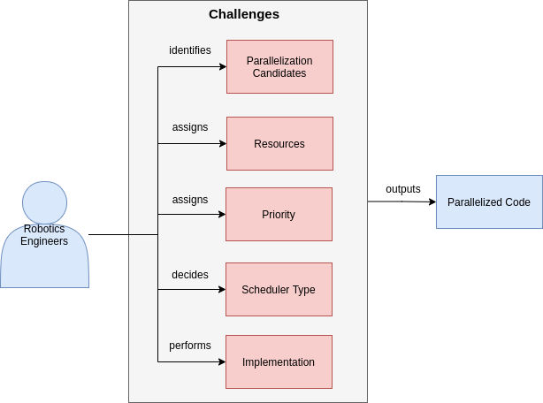
Challenges faced by Robotics Engineers
P4

Slide 16
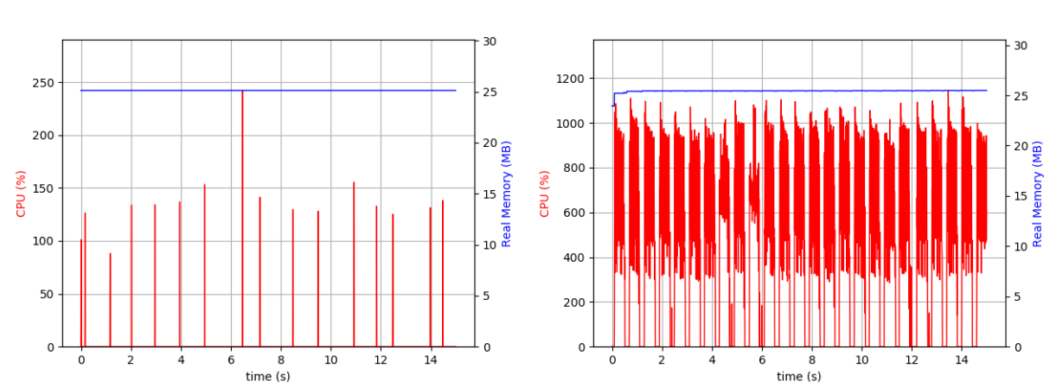
ROS2 and multi-threading
P4

Slide 17
Solution - LLAMBA
Software Stack
Take advantage of C++ facilities (templates, standard libraries)
Take advantage of embarrasingly parallel operations
Operating System
Take advantage of real-time kernel
Take advantage of scheduler type
Take advantage of processor affinity
Hardware
Take advantage of multi-cores
Take advantage of hyper-threading (INTEL CPUs)
Take advantage of caches
P4

Slide 18
Solution - LLAMBA
Identification of important parameters
Parallelization Component in C++
Benchmarking Component in C++
Python Bindings written in C++
Visualization Component
Input Scripts
Parallelize Functions
Integrations in ROS2
P4

Slide 19
Important Parameters
LLAMBA identified the following parameters to be of great importance to robotics engineers:
Threads Number (Logical)
Scheduler Type
Affinity
Parallelization approach (Pthread, OpenMP, etc.)
Furthermore, LLAMBA relies on these two performance related metrics to measure its efficiency:
Average Execution Time
Deviation between average execution time and worst case execution time
P4

Slide 20
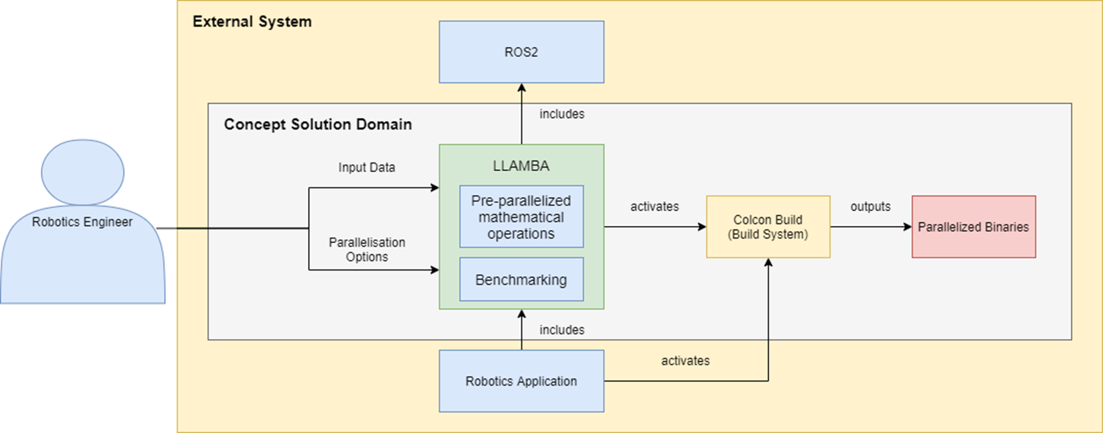
LLAMBA – Conceptual Solution
P4

Slide 21
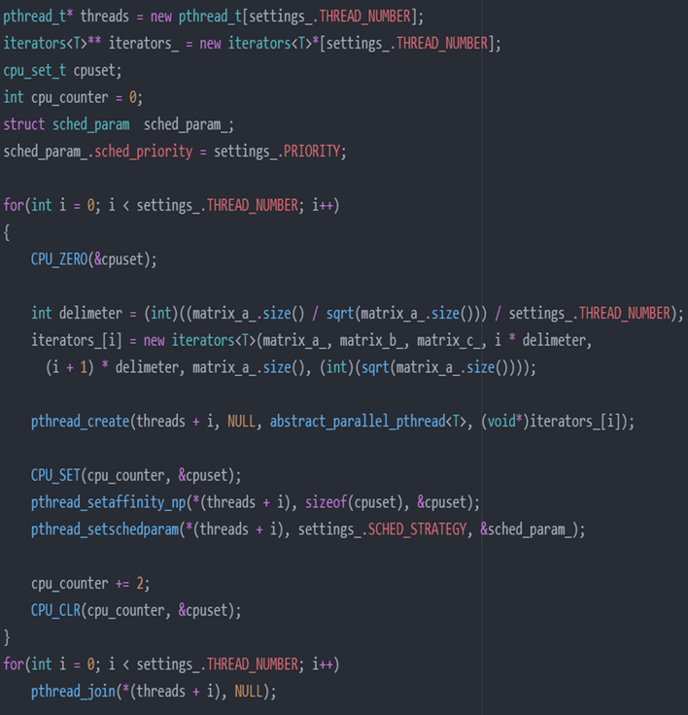
Manual Parallelization
P4

Slide 22
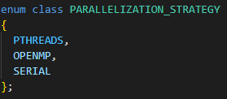
LLAMBA Parallelization
P4

Slide 23
LLAMBA Parallelization
P4

Slide 24
LLAMBA Parallelization
P4

Slide 25
LLAMBA Parallelization
P4

Slide 26
LLAMBA Parallelization
P4

Slide 27
LLAMBA Benchmarking
P4

Slide 28
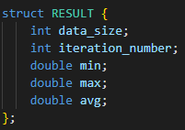
Python Bindings
P4

Slide 29
Python Bindings
P4

Slide 30
LLAMBA Visualization
P4

Slide 31
Input Scripts
Hardware Information:
Physical cores
Total cores
Max Frequency
Min Frequency
Current Frequency
P4

Slide 32
Parallelize Functions Feature
P4

Slide 33
Supported Operations
Basic linear algebra operations:
Matrix Multiplication
Matrix Summation
Grayscaling
Pixel Extraction
Matrix Inverse
Specific operations:
Bresenham 3D
StaticMap
Forward Kinematics
P4

Slide 34
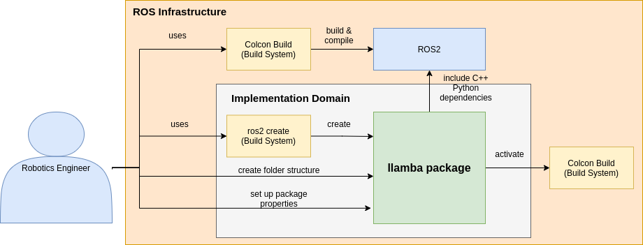
Integration in ROS2
P4

Slide 35
Evaluation
Quantitative Evaluation:
Average Execution Time
Deviation between average time and worst case execution time
Qualitative Evaluation:
Interview with experts and academics in Robotics
P4

Slide 36
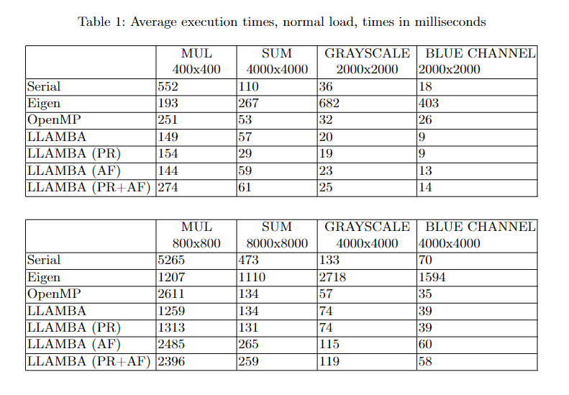
Average Execution Time
P4

Slide 37
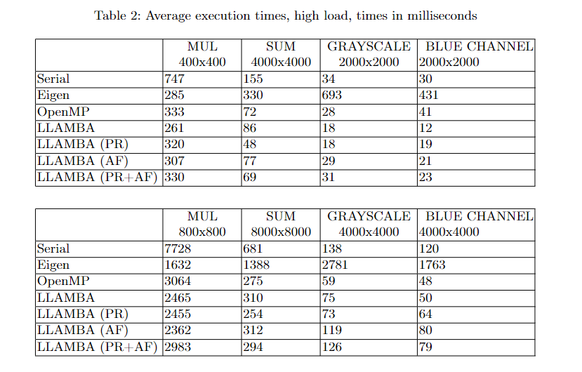
Average Execution Time
P4

Slide 38
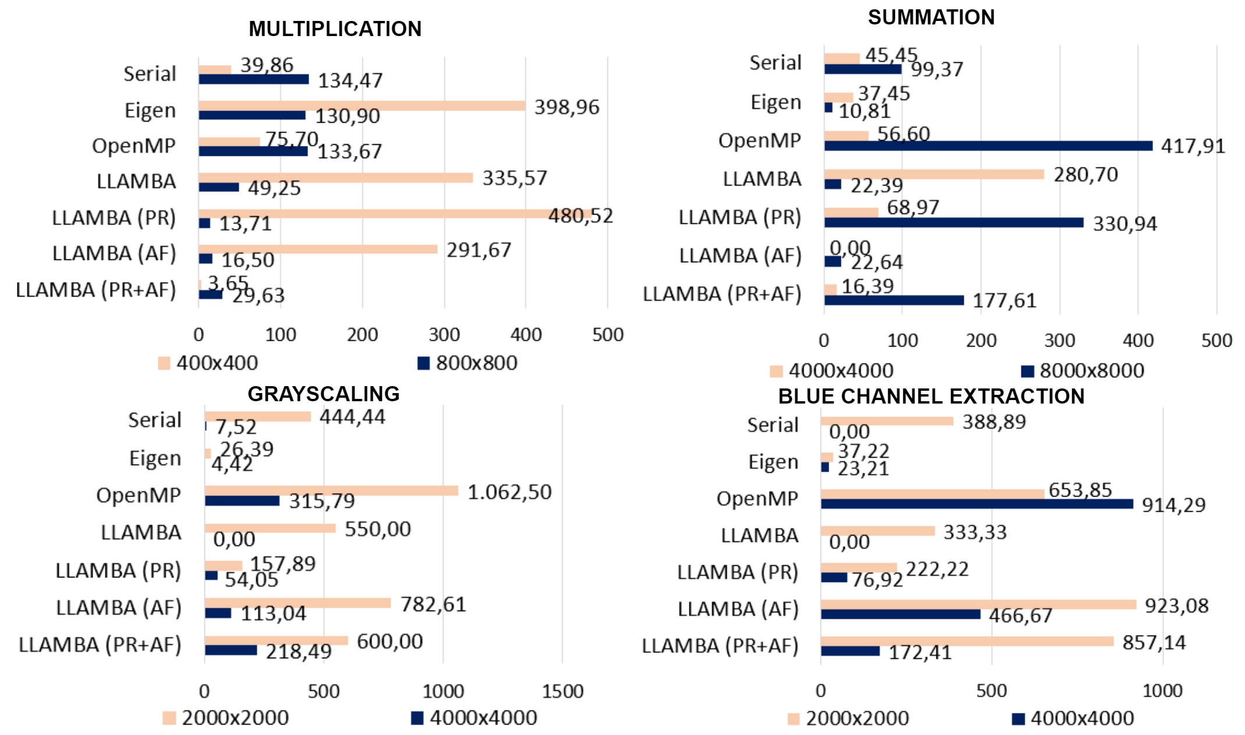
Deviation (max-min) / average
P4

Slide 39
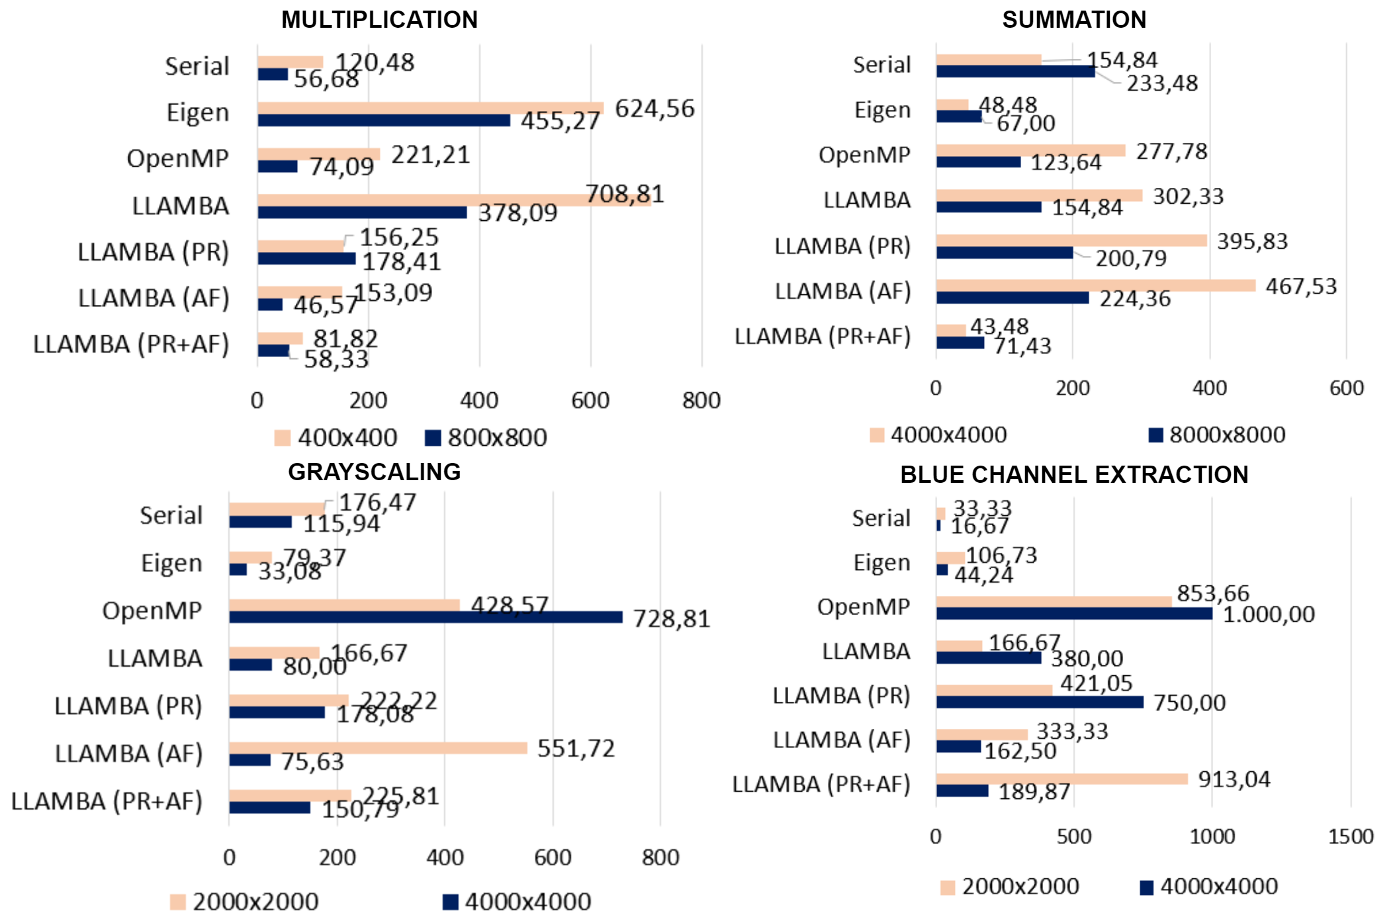
Deviation (max-min) / average
P4

Slide 40
Interviews
Question | Completely Agree | Agree | Neutral | Somewhat Disagree | Completely Disagree
The benefits of the Framework significantly outweigh the effort for its integration. | 16.7% | 33.3% | 50.0% | 0% | 0%
The Framework solves the most important issues we have regarding the parallelization. | 0% | 33.3% | 33.3% | 33.3% | 0%
The Framework offers enough pre-parallelized operations. | 16.7% | 50.0% | 33.3% | 0% | 0%
Considering our use case, the Framework offers enough parallelization options. | 16.7% | 50.0% | 33.3% | 0% | 0%
The Framework can be understood effortlessly. | 50.0% | 16.7% | 16.7% | 16.7% | 0%
After seeing this presentation, I am motivated to start using the Framework. | 16.7% | 50.0% | 16.7% | 0% | 16.7%
After seeing this presentation, I would consider replacing some of my existing implementations or libraries related operations with those from Framework. | 0% | 50.0% | 16.7% | 33.3% | 0%
After seeing this presentation, I am motivated to use the Framework to explore possible parallelization design options. | 16.7% | 50.0% | 16.7% | 16.7% | 0%
P4

Slide 41
Evolution
More mathematical operations
Synchronization Support
Real-Time Support
P4

Slide 42
Contact
—
M.Sc. Arian Ajdari
Architecture-Centric Engineering
Tel. +49 1525 8745024
arian.ajdari@iese.fraunhofer.de
Fraunhofer IESE
Fraunhofer-Platz 1
67663 Kaiserslautern
www.fraunhofer.de
Dr.-Ing. Jasmin Jahic
Computer Architecture Group
Tel. +49 1796531767
jj542@cam.ac.uk
University of Cambridge – Department of Computer Science and Technology
15 JJ Thomson Avenue
Cambridge CB3 0FD
https://www.cst.cam.ac.uk

Slide 43
Thank you for listening
—

