Slide 1
-memory_safe C++
JRadigan@Microsoft.com

Slide 2
Memory safety 2018 – continues to dominate
Discovered vulnerabilities continue to increase
~70% of all reported due to memory safety
Notes:
Static analysis is earlier in the development cycle (further left). These numbers are from a code base that uses static analysis. We are also still actively producing memory safety issues today.

Slide 3
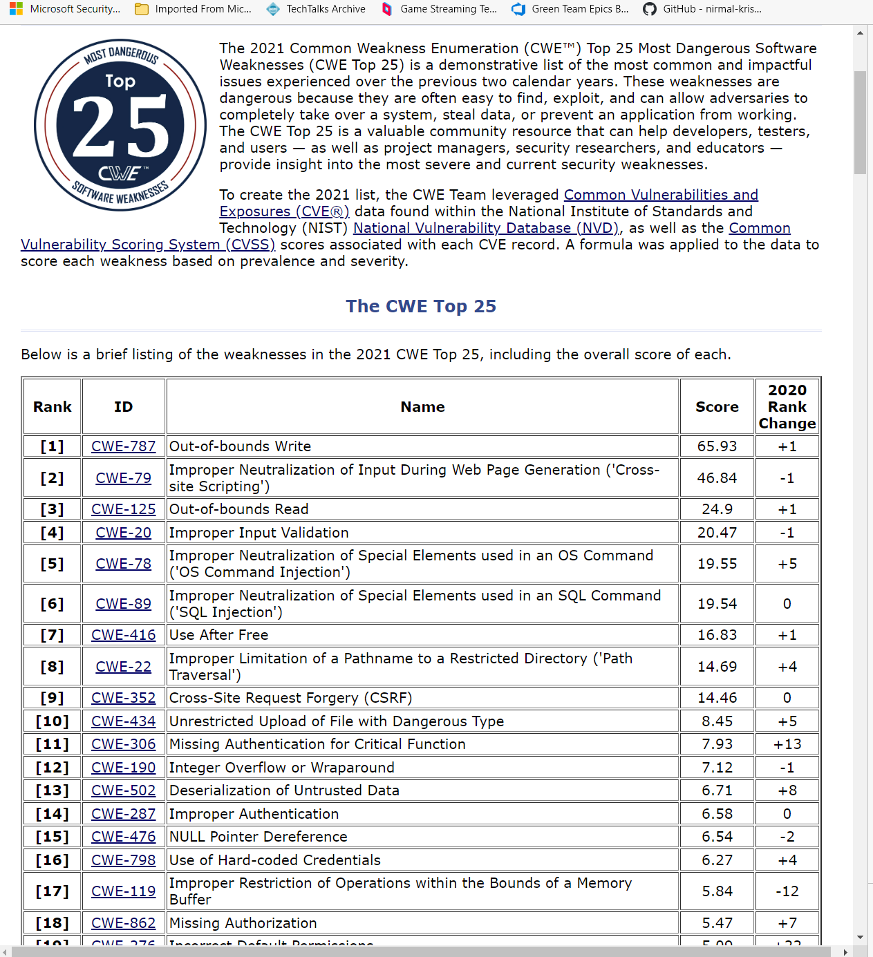
Memory Safety – 2021
(Rows 1, 3, 7, 12, 15, 17)

Slide 4
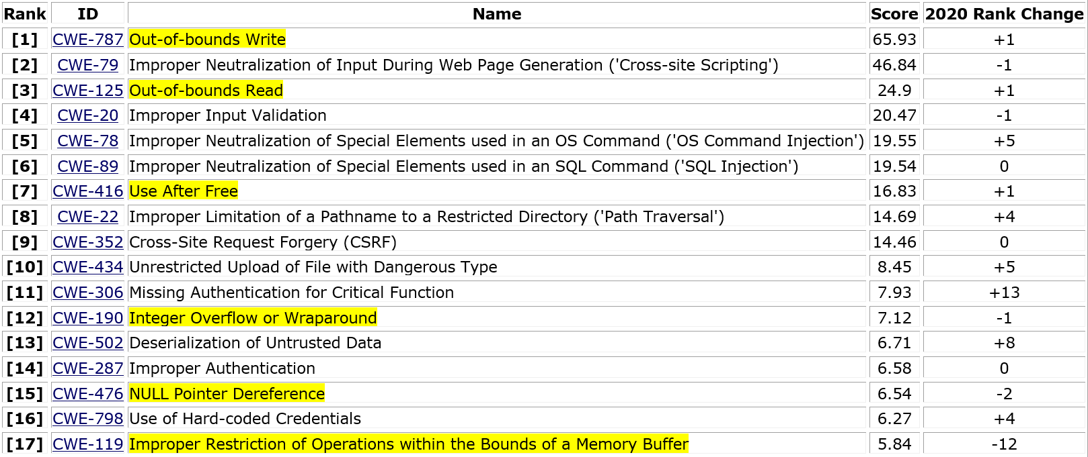
2021 – CWE Top 25
Common Weakness Enumeration (CWE™) Top 25 Most Dangerous Software Weaknesses

Slide 5
What’s in it for you…
Why memory safety - why it’s critically important.
A new tool - for C++ memory safety.

Slide 6
What’s in it for you… said differently
Bad guys - show why memory-safety is critically important
Good guys - a new tool

Slide 7
ROP - return oriented programming
DOP - data oriented programming
BOP - block oriented programming
DDM - direct memory manipulation
The “bad guys”
Ever heard of…
…they all use memory safety errors!

Slide 8
ROP – return oriented programming
(2007) The geometry of innocent flesh on the bone: return-into-libc without function calls
(2017) The Dynamics of Innocent Flesh on the Bone: Code Reuse Ten Years Later
Must reads!

Slide 9
Constant store to memory
Mem[val2] = val1;
…
val2
a1: mov eax, [esp]
a2: mov ebx, [esp+8]
a3: mov [ebx], eax
…
val1
esp
eax
val1
ebx
val2
eip
a1
a3
a2

Slide 10
Constant store – ROP gadget
Checkoway
Mem[val2] = val1;
a5
val2
eip
a1: pop eax
a2: ret
a3: pop ebx
a4: ret
a5: mov [ebx], eax
a3
val1
esp
eax
val1
ebx
eip
a2
a1

Slide 11
Checkoway – constant store “ROP gadget”
Mem[val2] = val1;
a5
val2
esp
a1: pop eax
a2: ret
a3: pop ebx
a4: ret
a5: mov [ebx], eax
a3
val1
eip
eax
val1
ebx
val2
a3
eip
a4

Slide 12
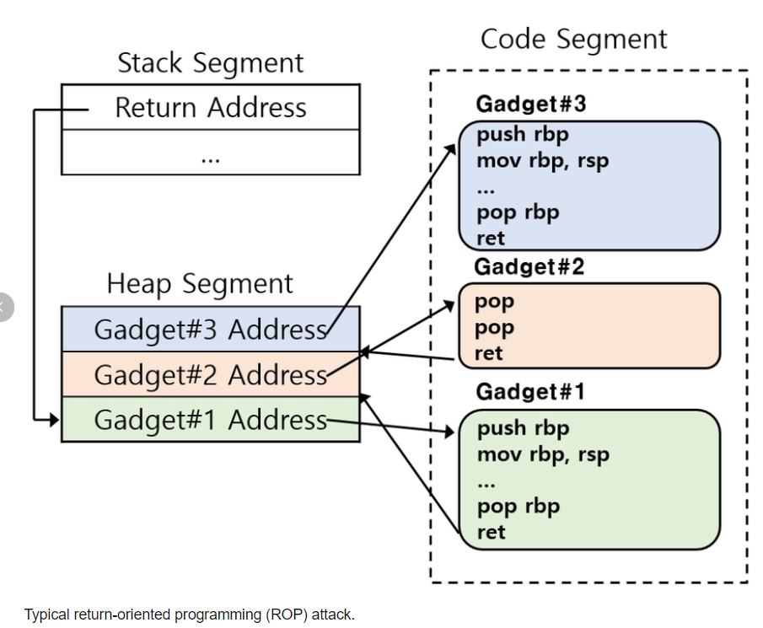
ROP gadget(s)

Slide 13
ROP – Turing complete
Usually: Arbitrary Turing-complete behavior
Arithmetic
Logic
Conditionals and loops
Subroutines
Calling existing functions
System calls
Sometimes: More limited behavior
Often enough for straight-line code and system calls

Slide 14
It can all start with → one memory safety error

Slide 15
Wait. What’s memory safety?

Slide 16
alloc-dealloc-mismatch
allocation-size-too-big
calloc-overflow
double-free
dynamic-stack-buffer-overflow
global-buffer-overflow
heap-buffer-overflow
heap-use-after-free
invalid-allocation-alignment
memcpy-param-overlap
new-delete-type-mismatch
stack-buffer-overflow
stack-buffer-underflow
stack-use-after-return
stack-use-after-scope
strncat-param-overlap
use-after-poison
Memory Safety
Asan find these with ZERO false positives
Notes:
For now, it’s this set of categories backed by specific source code examples that will compile.

Slide 17
What do we do?

Slide 18
C++ Security Technologies
Source Modifications
GSL
Attributes for drivers
SAL
#pragma(strict_gs, . . .
Writing a security blog:
Describe each tech.
How they compose
Static Analysis
Dynamic Analysis
/SDL
/Analyze
GSL Checker
SAL
plugins
Address Sanitizer
libFuzzer
CodeCoverage
Secure CodeGen
/GS /GS+
/XFG
/CastGuard
/CFG
/SafeEH

Slide 19
What’s secure code generation?

Slide 20
CFG – Control Flow Guard
Entries– compiler symbols
void function_A (int, int) { ... }
int function_B (int, int) { ... }
void function_C ( Object* ) { ... }
void Object::method1() { ... }
void Object::method1(int, int) { ... }
void Object::method2() { ... }
void Object2::method1() { ... }
((void (*) (int, int)) funcptr)(0, 1);
obj->method1();

Slide 21
CFG – Control Flow Guard
Target
.align 0x10
function:
push rbp
push rbx
push rsi
…
Call Site
mov rax, [rsi+0x98] ; load target address
call [__guard_dispatch_icall_fptr]

Slide 22
XFG – Control Flow Guard
Entries– compiler signatures
void function_A (int, int) { ... }
int function_B (int, int) { ... }
void function_C ( Object* ) { ... }
void Object::method1() { ... }
void Object::method1(int, int) { ... }
void Object::method2() { ... }
void Object2::method1() { ... }
((void (*) (int, int)) funcptr)(0, 1);
obj->method1();

Slide 23
XFG – Control Flow Guard
Call Site
mov rax, [rsi+0x98] ;function address
mov r10, 0xdeadbeefdeadbeef ;hash
call [__guard_dispatch_icall_fptr_xfg]
Target
.align 0x10
dq 0xcccccccccccccccc
dq 0xdeadbeefdeadbeef
function:
push rbp
push rbx
push rsi
…

Slide 24
C++ Security Technologies
Source Modifications
GSL
Attributes for drivers
SAL
#pragma(strict_gs, . . .
Static Analysis
Dynamic Analysis
/SDL
/Analyze
GSL Checker
SAL
plugins
Address Sanitizer
libFuzzer
CodeCoverage
Secure Code Generation
“bad guys added new tech.”
→ importance of Asan
Secure CodeGen
/GS /GS+
/XFG
/CFG
/CastGuard
/SafeEH

Slide 25
10 years on “control flow integrity” (CFI)
Ropr : A Blazing Fast Multithreaded ROP Gadget Finder
It continues…
Good guys→
Bad guys→

Slide 26
Control Flow Integrity (CFI) attacks
Also – they moved focused to data
Newer: Data oriented (DOP) attacks

Slide 27
Data-oriented attacks
Manipulate non-control data
(variable/pointer which does not contain a target address)
Change benign behavior
Without violating – control flow integrity (CFI)
… a simple DDM example… flipping a bit in a variable

Slide 28
DOP - Data oriented programming
BOP – Block oriented programming
DDM – Direct memory manipulation
Data oriented attacks
→ Use the C++ Address Sanitizer

Slide 29
SPL – SPloit Language and compiler
void payload()
{
3 string prog = “C:\Windows\System32\cmd.exe\0”;
4 int argv = {&prog, 0x0};
5 __r0 = &prog;
6 __r1 = &argv;
7 __r2 = 0;
8 _execve(__r0, __r1, __r2);
9 }

Slide 30
SPL - Compiler
Disassembled binary
BB(1)
rax = 10
rax
SPL
Line #1 __r0 = 10;
Line #2 __r1 = 20;
Line #3 __r2 = 30;
__r0
rbx
__r1
rcx
__r2
rdx
rbx = 20
BB(3)
rcx = 10
BB(2)
BB(6)
rdx = 20
BB(7)
rdx = 30
BB(4)
rcx = 30
BB(5)
rax=20

Slide 31
An Association – for 3 SPL statements
Line #1
BB(1)
rax=10
rcx=10
rax
__r0 → RAX
__r1 → RBX
__r2 → RCX
One association
_r0
rbx
Line #2
_r1
BB(2)
rbx=20
rax=20
rdx=20
rcx
_r2
Line #3
rdx
BB(4)
rcx=30
rdx=30

Slide 32
→ “what-where” list
Path in binary to get 1-2-4
BB(1)
rax = 10
Symbolic execution
BB(2)
rbx = 20
rcx = 10
BB(4)
rdx = 20
rdx = 30
rcx = 30
rax=20

Slide 33
It all starts here
alloc-dealloc-mismatch
allocation-size-too-big
calloc-overflow
double-free
dynamic-stack-buffer-overflow
global-buffer-overflow
heap-buffer-overflow
heap-use-after-free
invalid-allocation-alignment
memcpy-param-overlap
new-delete-type-mismatch
stack-buffer-overflow
stack-buffer-underflow
stack-use-after-return
stack-use-after-scope
strncat-param-overlap
use-after-poison
“bad guys call these”
(AWP) Arbitrary Write Primitives
Memory Safety Errors
Notes:
For now, it’s this set of categories backed by specific source code examples that will compile.

Slide 34
Windows Movie Maker
Heap overflow vulnerability
HRESULT CDocManager::IsValidWMToolsStream(bool* pfValid)
{
long cbSize;
if(FAILED(hr = ExtractDataSize(strPath, &cbSize)))
return S_OK;
CSmartPtr<BYTE> pBuffer = new BYTE[cbSize];
ExtractData(strPath, pBuffer, cbSize);
long dwCheckSum = DwChecksumFromLpvCb(0, pBuffer, cbSize);
long dwStreamCnt = GetStreamCount(m_pVisitedTree);
if(FAILED(hr = ExtractDataSize(kszCheckSumStream, &cbSize))) {
return S_OK;
}
//ExtractData(kszCheckSumStream, pBuffer, cbSize);
for(int i=0; i<cbSize; i++) {
  *pBuffer++ = *kszCheckSumStream++;
}
}
1. cbSize assigned 4470
2. allocate buffer with 4470 bytes
3. cbSize re-assigned 4496
Heap Overflow!
Leads to Hijack

Slide 35
SQL Slammer
Stack overflow vulnerability
BOOL SsrpEnumCore( LPSTR szInstanceName, …)
{
char szregKey[512];
char szregVersion[128];
szInstances = (LPSTR)calloc((strlen(szInstanceName)+2), sizeof(char));
if( !szInstances ) goto ErrorExit;
strcpy(szInstances, szInstanceName);
szInstName = szInstances;
while( strcmp(szInstName, "") ) {
if( !stricmp(szInstName, "MSSQLServer") ) {
strcpy(szregKey, DEFREGKEY);
strcpy(szregVersion,
"Software\\Microsoft\\MSSQLServer\\MSSQLServer\\CurrentVersion");
} else {
sprintf(szregKey, "%s%s\\MSSQLServer\\SuperSocketNetLib\\",
INSTREGKEY, szInstName);
sprintf(szregVersion, "%s%s\\MSSQLServer\\CurrentVersion",
INSTREGKEY, szInstName);
}
}
1. Instance name read from a socket
2. Stack buffer overflow
Hijack!
Return address corrupted

Slide 36

Use-after-free
Victim: Delete object: ~obj();
Attacker: Overwrite the VTable space so entry
(e.g., obj->vtable[_foo_index]) points to gadget.
Victim: Use dangling pointer: obj->foo();

Slide 37
IE Aurora
Dangling pointer vulnerability
2. Copy evt, but fail to AddRef on CTreeNode!
<html><head><script>
var e1;
function f1(evt){
e1 = document.createEventObject(evt);
document.getElementById("sp").innerHTML = "";
window.setInterval(f2, 50);
}
function f2(){
var t = e1.srcElement;
}
</script></head>
<body>
<span id="sp">
<img src=“any.gif" onload=“f1(evt)">
</span>
</body></html>
3. Destroy img tag in span leading to free when evt falls out of scope
Hijack!
Vtable call via freed CTreeNode
4. Call f2 async so evt goes out of scope
1. Pass onload event (evt) to f1
Red is C++ called from javascript

Slide 38
Inflation - Nation state actors
Hiring crisis ☺

Slide 39
No really, Jim. How bad is it?

Slide 40

NISTIR 8397 “Guidelines on Minimum Standards for Developer Verification of Software”
We’re from the government. We’re here to help.

Slide 41
The bad guys – ROP, DOP, BOP, DDM
The good guys

Slide 42
Delivering in C++ requires both static analysis (SA) ← compile time dynamic analysis (DA) ← runtime

Slide 43
C++ Security Technologies
Source Modifications
GSL
Attributes for drivers
SAL
#pragma(strict_gs, . . .
Dynamic Analysis
in IDE
Static Analysis
in IDE
Static Analysis
Dynamic Analysis
/SDL
/Analyze
GSL Checker
SAL
plugins
Address Sanitizer
libFuzzer
CodeCoverage
Secure CodeGen
/GS /GS+
/XFG
/CFG
/CastGuard
/SafeEH

Slide 44
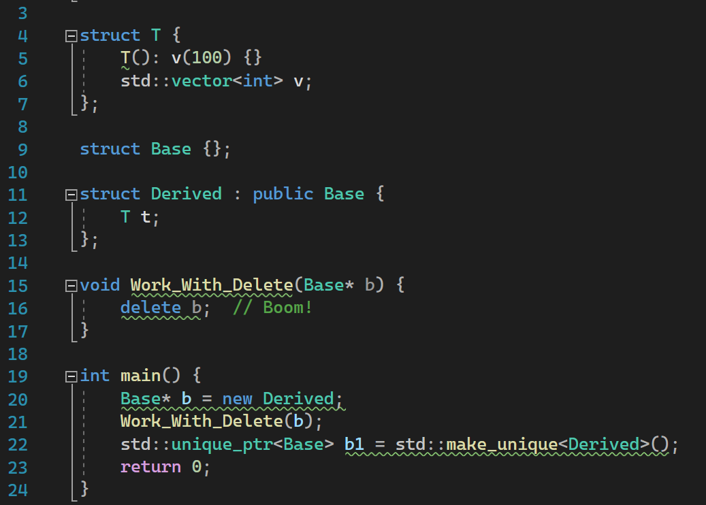
DEMO static and dynamic analysis

Slide 45
C++ language - limits static analysis at compile time
*q = …
Type propagation
p->foo(&a, &b);
Alias analysis

Slide 46
Dynamic Analysis → at runtime
Address Sanitizer

Slide 47
Simple recompile – add compiler flag
Built on two techniques
Runtime tests
“Hooked” - allocators, deallocators, memcpy, memset …

Slide 48
Simplified Code Generation
*p = x + y;
if (ShadowByte::Bad(p) )
AsanRt::ReportDie(p,sz)
*p = x + y
Complex functionalities support this paradigm for any load or store

Slide 49
Basics
8-bytes 8-bits
(application memory) (shadow-bytes)
0
7
6
5
4
3
2
1
0xF8
0xF8
4
“poisoned”
GOOD – program allocated
BAD – never allocated by program

Slide 50
Runtime “hooking” – powerful functionalities
call Malloc
_malloc:
Malloc Body
call Malloc
_malloc:
jmp _asan_malloc
ret
Malloc Body
_asan_malloc :
ASAN WORK
jmp malloc_ret

Slide 51
Intercepting or “Hooking” the CRT → very powerful !
1. Size of all heap allocations
2. Complete call stacks at
Allocate()
  Free()
3. Built in checks for
memcpy(), strncpy(), memset() …
4. Initialization

Slide 52
Address Sanitizer
Compile in runtime checks
Link to Asan.lib
Diagnose errors at runtime
Dynamic analysis – a simple recompile
Need good code coverage → libFuzzer

Slide 53
One-n-Done → new tool
First time on 200,000+ tests on 100+ machines …
…one-n-done can be disruptive $$$

Slide 54
New Asan runtime → think /Od++

Slide 55
Amazing team:
Amy Wishnousky
Zachary Johnson
Kemi Porto
Mahmoud Saleh
Bran Hagger

Slide 56
Runtime – major changes
Interop+compat – full Windows Platform
Continue-on-error(s)

Slide 57
Interop and compat - full Windows Platform
Windows Allocators
Interception of underlying RTL allocation functions
Private heap tracking - support heap flag options and heap destruction.
Up-to-date interception or ”hooking”
Windows new OS security features, like XFG
Compatibility with DLL scenarios
Detection of allocations made prior to ASAN initialization.
DLLs which overwrite Import Address Tables (graphics driver scenarios)

Slide 58
Windows – Hook/intercept extra API’s
Always
  malloc / free / calloc / msize / expand
  operator new / delete
  RtlAllocateHeap
  RtlFreeHeap
  RtlReAllocateHeap
  RtlSizeHeap
  RtlDestroyHeap
ASAN_OPTIONS=windows_hook_legacy_allocators
  GlobalAlloc / GlobalFree / GlobalSize / etc
  LocalAlloc / LocalFree / LocalSize / etc

Slide 59
Asan – concurrency on Windows
“Wild pointers” and Dead Lock

Slide 60
Windows ASan – Detecting “wild pointers”
Reentrancy with the Low Fragmentation Heap
1 Ntdll RtlFreeHeap → ASAN::RtlFreeHeap
2 Take Win32 lock. Determine ownership: RTL
6 Use Win32 lock to determine ownership: Unknown
3 Actual RtlFreeHeap
7 ASAN Asserts “wild pointer found”
4 Use Low Fragmentation Heap
5 LFH Frees Internal Bookkeeping node

Slide 61
Asan - 2 new locks, 3 total
Lock Order to Avoid Deadlocks
Win32 Heap Lock
>
RTL Reentrancy Lock
>
Memory Map Lock
Must be taken when checking heap for pointer ownership.
Track allocations for private heaps to properly handle RtlDestroyHeap
Only taken when current heap is LFH.

Slide 62
Status
Open-Source Software – weekly testing
185 OSS projects - built with latest compilers, then tested.
148 OSS projects - with Asan (x86 and X64)

Slide 63
OSS Projects - Asan bugs on Windows
Patterns From OpenSource – Boost, OpenSSL, Azure IOT SDK
RapidYaml
Bond
Terminal
Librealsense
SpdLog
RapidJason
CataClysm-DDA
FreeCAD
OpenSSL
MyTinySTL
MuseScore
Vowpal_wabbit
Assimp
Arrow
LibZMQ
Aleth
Pbrt-v3
ppsspp
Or-tools
Mixx
QT6
Sogou_workflow
Renderdoc
Oatpp
Evpp
Cpprestsdk
TDlib

Slide 64
NEW tool - Continue-on-error
Think /OD+
Eliminate LLVM_SYMBOLIZER.EXE
Move Asan internal meta-data
…“bad” writes can now clobber Asan internals!

Slide 65
LLVM_SYMBOLIZER.EXE
Application.exe
call stack entry
llvm_symbolzer.exe
Asan Runtime
entry source symbol
CRT for memory safety
C++ runtime

Slide 66
Bad writes – clobber Asan meta-data
void main () {
if (ShadowByte::Bad(A-4) )
A[-1] = 3.14159;
}
AsanRt::ReportAndDie(A-4,size)
AsanRt::ReportContinue(A-4,size)
→ …moved all heap meta-data, changed error reporting

Slide 67
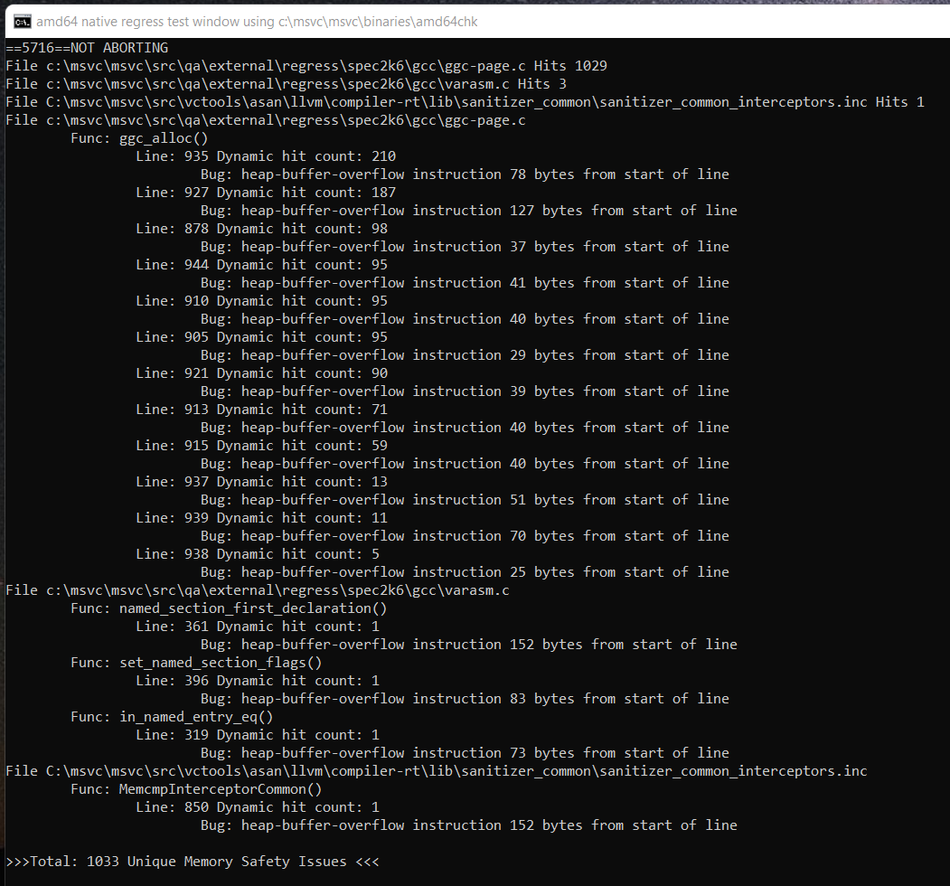
DEMO – spec2k6/GCC

Slide 68
Schedule - continue on error
VS2022 17.5 Preview 1
11/08

Slide 69
Upstream to LLVM 11
Origin Master
LLVM 11
Continue-on-error
+ interop
+ RTL intercepts
+ new locks
LLVM 10
LLVM 9

Slide 70
AddressSanitizer - the “real” Windows Platform
Additional work in flight:
Improved Compatibility with mixed DLLs ( /MT, /MD, w/wo Asan )
Compatibility with all Managed Code ( C#, C++ /CLI )

Slide 71
COMPILER

Slide 72
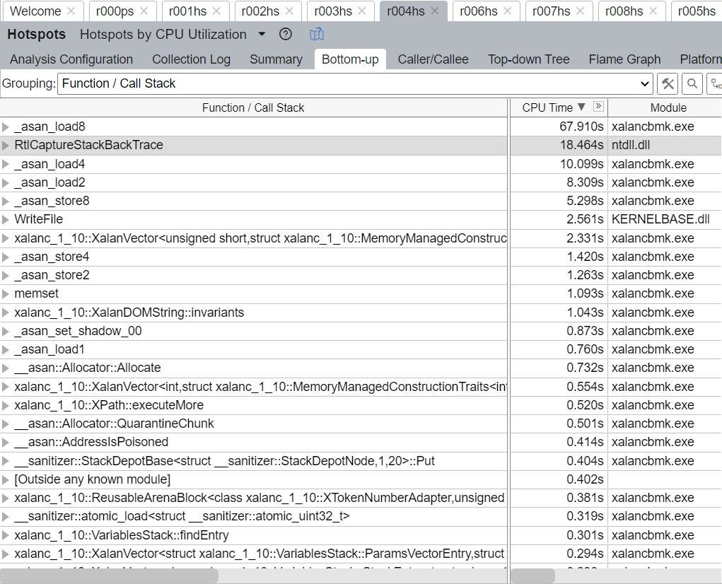
Profile spec2017\xalanc + gcc
Top 5: Tests + stack meta-data →

Slide 73
Optimize - runtime tests
Escape analysis – with /O2 /GL 50% local checks
Range check elimination – 20% heap + global pointer checks
Hidden updates - 20% heap + global checks

Slide 74
Hidden update
*p = &r // Change typeof(q)
p :
**p = 13
q :
d :
DerivedShape
r :
BaseShape

Slide 75
The points-to-graph - analyze tests
p
q
d (DShape)
r (BShape)

Slide 76
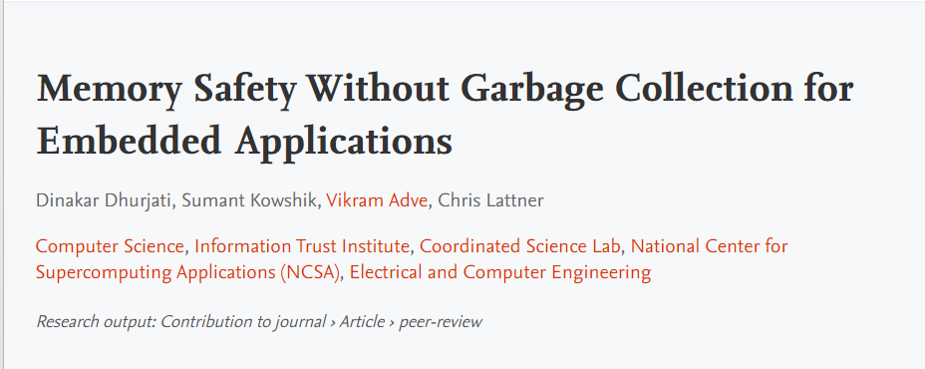
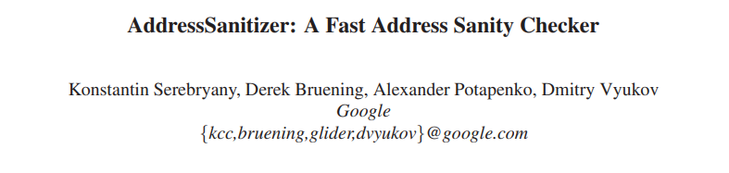
Additionally -memory_safe builds on
Chris Lattner 2005
Foot note 1
+
Konstantin Serebryany 2012
Notes:
What we’re delivering might have just fallen out naturally if these guys published in reverse order. If the compiler work was developed knowing it could target an Address Sanitizer-like runtime.

Slide 77
-memory_safe – added restriction
Initialize local pointers before any use
int a, *p, **p;
pp = &p; ← Compiler to initialize p = nullptr
printf(**pp)
p = &a

Slide 78
-memory_safe – use rule to optimize
C# type system rule (or fall back)
No local address returned by a function
No local address stored to heap or global variable

Slide 79
cl -memory_safe
Optimize
  Runtime checks
  Runtime meta-data
  Memory usage - /O2 on by default (/O2/GL encouraged)
  Runtime
  Interop
  Continue-On-Error(s)
Shooting for → cl /Od /RTC++

Slide 80
Can NOT change things without you!
Why this is so important – “bad guys”
New runtime + compiler – FOR YOU
Notes:
New compiler and runtime are certified for memory safe C++ development.

Slide 81
Build on code more than 2 years old?
What’s your level of memory safety?

Slide 82
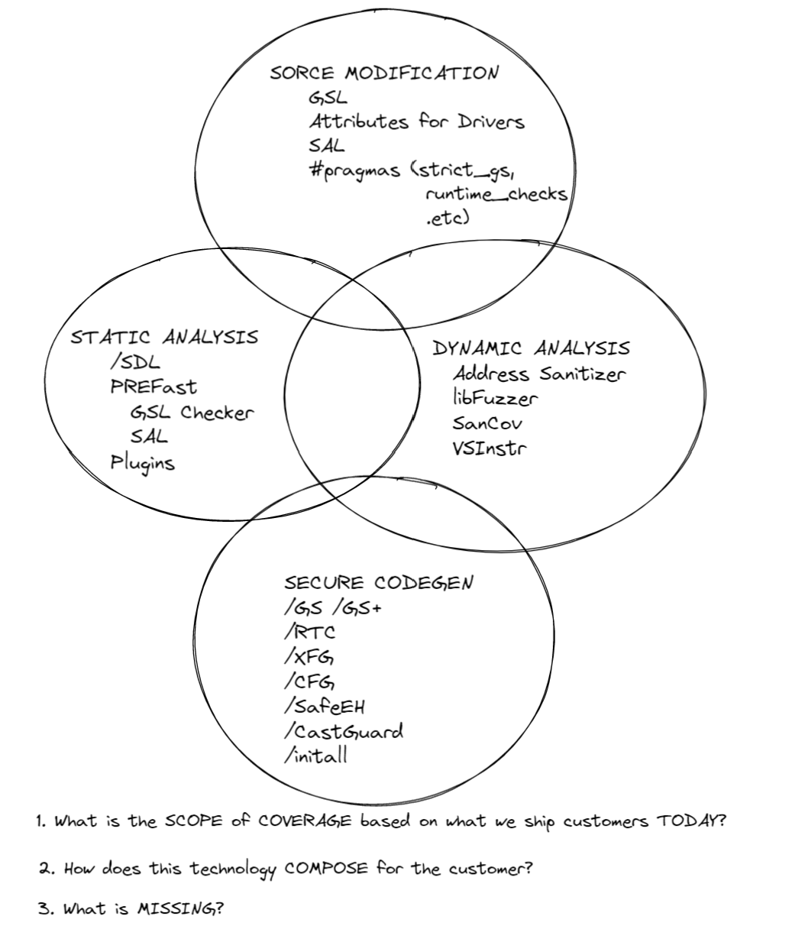
Microsoft
Security Technologies
.
BLOG

