Slide 1
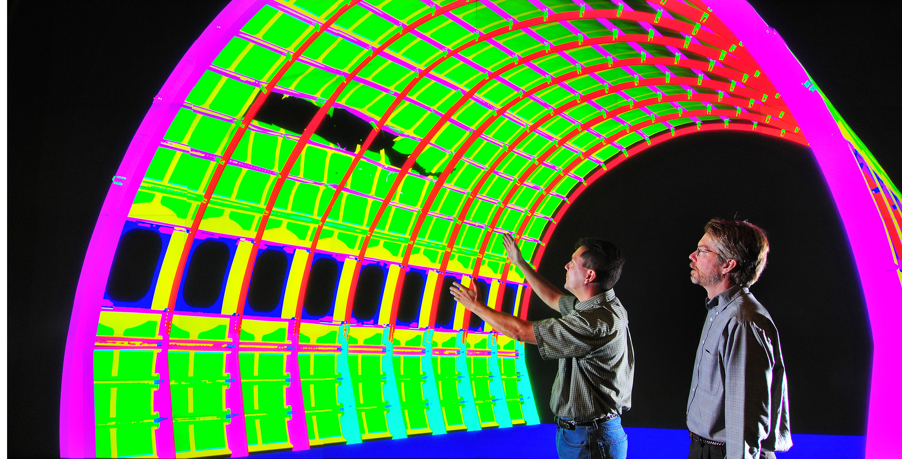
A Decade of Performance Portability – Lessons Learned
Christian Trott
Sandia National Laboratories, Center for Computing Research
SAND2022-12174 C

Slide 2
Goal of this talk.
Demonstrate issues of heterogeneous hardware and performance portability from a C++ software design perspective.
Show how the C++ Performance Portability Programming Model Kokkos addresses these concerns in its design.
Connect it all to the design of C++23 mdspan and (hopefully) C++26 stdBLAS.
Summarize lessons learned beyond C++ design decisions to achieve practical performance portability.

Slide 3
Non-goals of this talk and omitions
Give an Introduction to Kokkos.
Cover lessons for asynchronicity and task systems – that’s another hour of talk.
Explain how GPUs and other accelerators work.

Slide 4
Outline
The HPC Hardware and Software Landscape
Performance Portability Challenges And How to Tackle Them
Building Blocks in the (future) ISO C++ Standard
Final Thoughts

Slide 5

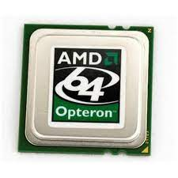

Why we need Performance Portability
TOP 500 Supercomputer
10 highest ranked 11/2007
Intel Xeon 4C
3 Systems
AMD Opteron 2C
3 Systems
IBM PowerPC
4 Systems – 2C/4C

Slide 6
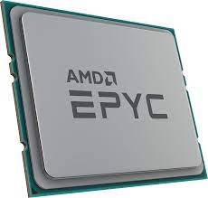
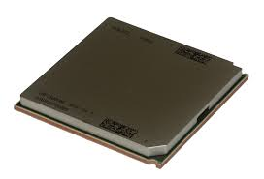




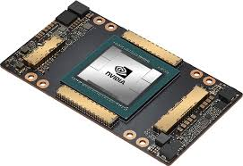



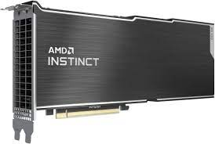

Why we need Performance Portability
TOP 500 Supercomputer
10 highest ranked 06/2022
Threading
Building
Blocks
CPUs:
std::thread
AMD EPYC
5 Systems
IBM Power9
2 Systems
Intel Xeon
1 System
Fujitsu ARM
1 System
Sunway MPP
1 System
Accelerators:
NVIDIA GPUs
4 Systems
AMD GPUs
3 Systems
Sunway SW26010
1 System
Matrix-2000
1 System
Hardware Architectures and the Means To Program Them Have Diversified

Slide 7
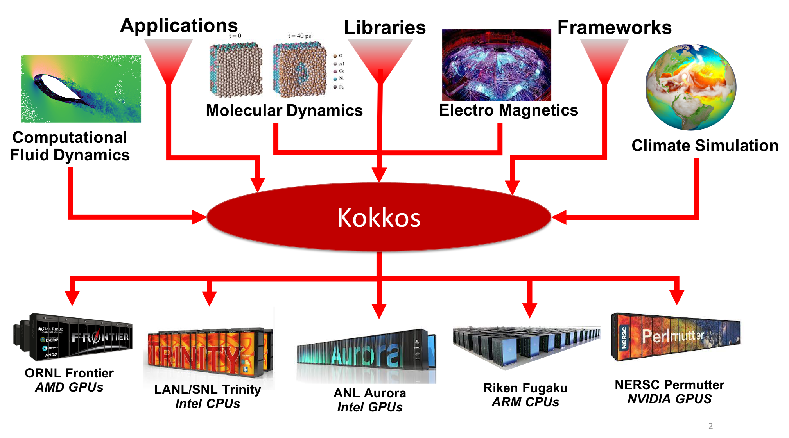
The Kokkos EcoSystem

Slide 8




What is Kokkos?
A C++ Programming Model for Performance Portability
  Implemented as a template library on top of CUDA, OpenMP, HPX, …
  Aims to be descriptive not prescriptive
  Aligns with developments in the C++ standard
  Replaces usage of CUDA, OpenMP, HIP, etc.
Expanding solution for common needs of modern science/engineering codes
  Math libraries based on Kokkos
  Tools which enable insight into Kokkos
It is Open Source
  Maintained and developed at https://github.com/kokkos
It has many users at wide range of institutions.
Kokkos is NOT just for GPUs!

Slide 9
The Kokkos EcoSystem

Slide 10



The Kokkos Team

Slide 11
Kokkos Usage
https://kokkosteam.slack.com
Kokkos @ Sandia National Laboratories
Primary Programming Model for ASC and CSSE
Used instead of CUDA/HIP/OpenCL/OpenMP
>900 Registered Users
>130 Institutions
Kokkos @ DOE Exascale Computing Project
>50% of C++ codes in ECP use Kokkos
<10% of C++ codes use directly CUDA/HIP/SYCL/OpenMP
Applications and Libraries
Estimated 150-250 HPC projects using Kokkos
On the order of three-dozen apps run science and engineering production runs with Kokkos
  Many apps use multiple Kokkos based libraries
Similar distribution as the Slack User

Slide 12
Performance Portability Challenges and
How to Tackle Them

Slide 13
Device and Host Functions
struct Foo {
int val[4];
int& operator[] (int i) { return val[i]; }
const int& operator[] (int i) const { return val[i]; }
};
__global__ void foo_kernel(Foo f) {
printf("Kernel: %i\n",f[2]);
}
void foo() {
Foo f{1,2,3,4}; // Create Object
foo_kernel<<<1,1>>>(f); // Dispatch Kernel
}
nvcc --std=c++17 main.cu
main.cu(14): error: calling a __host__ function("Foo::operator [](int)") from a __global__ function("foo_kernel") is not allowed
main.cu(14): error: identifier "Foo::operator []" is undefined in device code

Slide 14
Device and Host Functions
We need device compilation markup!
struct Foo {
int val[4];
__host__ __device__ int& operator[] (int i) { return val[i]; }
__host__ __device__ const int& operator[] (int i) const { return val[i]; }
};
Fundamental Problem: There are two instructions sets: CPU and GPU
Why not just compile everything twice?
GPU functions can’t handle everything
  Allocation is limited
  Inline assembly or intrinsics for CPU archs
  System calls
  Can’t protect with “ifdef __AVX__” since macros may be the same for all compilation phases
Would need speculative compilation, but what about compilation time??
Consequence: Most of the C++ stdlib does not work in heterogeneous architectures!

Slide 15
Lesson Learned 1:
Single source compilation for heterogeneous architecture requires some form of “host/device” function attributes.
Related Expert Lessons:
Function pointers to the same function have different values depending where they are obtained!
That makes virtual functions fairly tricky to use!

Slide 16
Dispatch to devices and the challenge of value semantics
Lets say I want to modify the data members of Foo in a kernel:
__global__ void foo_kernel(Foo& f) {
printf("Kernel: %i\n",f[2]);
f[2] = 99;
}
void foo() {
Foo f{1,2,3,4};
foo_kernel<<<1,1>>>(f);
}
Crashes at runtime:
CUDA Exception: Warp Illegal Address
The exception was triggered at PC 0xd038d0
Thread 1 "a.out" received signal CUDA_EXCEPTION_14, Warp Illegal Address.
Some memory may not be accessible from all execution resources!
Consequence: Containers with value semantics are not useable!

Slide 17
Lesson Learned 2:
Data structures accessed in compute kernels need to have reference semantics.
Related Expert Lessons:
Proper reference counting is difficult and/or costly across architecture boundaries.
Kokkos simply waits for all outstanding asynchronous work before deallocating.

Slide 18
ParUnseq – The need to restrict guarantees to users
Strong forward progress guarantees are not a given on many accelerator architectures.
__global__ void deadlock(int* lock, int N) {
if(threadIdx.x==0) {
int count = 0;
while(atomicCAS(lock,1,0)!=1 && count<N) {
count++;
}
} else {
atomicCAS(lock,0,1);
}
}
__global__ void no_deadlock(int* lock, int N) {
if(threadIdx.x==0) {
atomicCAS(lock,0,1);
} else {
int count = 0;
while(atomicCAS(lock,1,0)!=1 && count<N) {
count++;
}
}
}
”deadlocks” on NVIDIA GPUs pre Volta and AMD GPUs
Does not ”deadlock” on NVIDIA GPUs and AMD GPUs
Some accelerators might not have the concept of a thread at all: e.g. data-flow architectures.
Consequence: Only par_unseq can be portably mapped to all architectures!

Slide 19
Lesson Learned 3:
Parallel unsequenced loops are the fundamental building block for performance portable code.
Related Expert Lessons:
Task systems are possible and useful, but tasks need to contain data parallel unsequenced loops to achieve performance.

Slide 20
Kokkos Basics
// matrix add using 2D Kokkos Views, two Views (X,Y) represent const data
void matrix_add( Kokkos::View<float**> Z,
Kokkos::View<const float**> X,
Kokkos::View<const float**> Y) {
int N = X.extent(0);
int M = X.extent(1);
// Dispatch N unsequenced calls to the lambda
// KOKKOS_FUNCTION contains appropriate device markup
// Note: capture by value so we can access a copy on the device
Kokkos::parallel_for(N, KOKKOS_LAMBDA (int i) {
for(int j=0; j<M; j++) Z(i,j) = X(i,j) + Y(i,j);
});
}
Primary data structure: Kokkos::View
Reference counted multi dimensional array
More details later
Primary work dispatch:
parallel_for loop with par_unseq semantics
Capture by value (e.g. ‘KOKKOS_LAMBDA’ == ‘[=] __host__ __device__’ for CUDA/HIP)

Slide 21
Data Accessibility and How to Control Where to Execute
Reminder: not all memory is accessible from everywhere!
How do we control where code executes, and where memory is allocated?
Execution Spaces and Memory Spaces!
Kokkos Execution and Data Structure are strongly typed with respect to accessibility.
template<class MemorySpace>
void matrix_add( Kokkos::View<float**, MemorySpace> Z,
Kokkos::View<const float**, MemorySpace> X,
Kokkos::View<const float**, MemorySpace> Y) {
int N = X.extent(0);
int M = X.extent(1);
using exec_t = typename MemorySpace::execution_space;
Kokkos::parallel_for( Kokkos::RangePolicy<exec_t>(0,N), KOKKOS_FUNCTION [=] (int i) {
for(int j=0; j<M; j++) Z(i,j) = X(i,j) + Y(i,j);
});
}

Slide 22
Lesson Learned 4:
Execution and Memory Resources need to know about each other.
Related Expert Lessons:
Portably expressing more subtle memory semantics such as page migration is a concern.
Types are not necessarily enough – need instances to support multiple discrete GPUs or multiple queues on a single GPU.

Slide 23
The curse of cached vs coalesced data access
void matrix_add( int N, int M, float* Z, const float* X, const float* Y) {
Kokkos::parallel_for( N, KOKKOS_FUNCTION [=] (int i) {
for(int j=0; j<M; j++) {
#ifdef // USE_C_LAYOUT
int index = i * M + j;
#else // USE_FORTRAN_LAYOUT
int index = i + j * N;
#endif
Z[index] = X [index] + Y [index];
}
});
}
On GPUs “adjacent” threads want to do coalesced access – i.e. access elements on the same cache-line.
On CPUs threads rely on prefetching and avoiding of false sharing for performance – i.e. different threads should access different cache lines.
Optimal storage order for an algorithm depends on architecture!

Slide 24
Lesson Learned 5:
Data Layout Mappings need to be configurable and integral part of the API design.
Related Expert Lessons:
Task systems are possible and useful, but tasks need to contain data parallel unsequenced loops to achieve performance.

Slide 25
MemoryTraits: customization point for special access hardware
Modern architectures have many special memory access paths
Atomic operations
Non-temporal reads
Special purpose caches
Example: GPU Texture Cache
Cache for read-only random access with locality
Access scenario in many physics/engineering codes
  Dominated by local interactions …
With Kokkos simple type change of View:
L1: View<const double*[3], LayoutRight>
Texture: View<const double*[3], LayoutRight, MemoryTraits<RandomAccess> >
Missing significant performance when not leveraging special access hardware!

Slide 26
Lesson Learned 6:
More and more special hardware capabilities exist –
for full performance these need to be leveraged.
Related Expert Lessons:
Wherever possible expressing access behavior via descriptive properties is preferrable over prescriptive settings (e.g. const RandomAccess vs. TextureCache).

Slide 27
Kokkos View
template<class DataType, class Layout, class Space, class MemoryTraits>
class View;
DataType: Scalar type and extents of the array
int* : rank-1 with one runtime dimension
const int*[5] : rank-2 const data, one runtime, one compile-time dimension
double**[4][2] : rank-4 with two runtime, two compile-time dimensions
Layout: Mapping multi-dimensional index to an offset
LayoutLeft : Fortran array style ordering
LayoutRight : C-array style ordering
LayoutStride : Arbitrary strides in each dimension
LayoutTiled : Tiled data layout
Space: Memory Location
HostSpace : Native memory space of the process thread
CudaSpace : Cuda device accessible memory space
CudaUVMSpace : Host/Device accessible memory space with page migration
CudaHostPinnedSpace : Host/Device accessible memory space, with pages pinned in host memory
MemoryTraits: Change access behavior such as “restrict”, “aligned” and “atomic”

Slide 28
Hierarchical Hardware and Parallelism
Lets look at the matrix add with different problem sizes, but keep NxM constant.
Need 100,000 rows to saturate the GPU bandwidth!

Slide 29
GPU Architecture
Scheduler
GPUs consists of [NVIDIA/AMD]
Up to 132/104 Multiprocessors
Each of which has up to 64/32 resident warps/wavefronts
Each of which has 32/64 threads
Registers
Registers
Registers
Streaming Multiprocessors
L1/Tex
Scratch
L1/Tex
Scratch
L1/Tex
Scratch
L2*
GPUs have up to 270,000 resident threads!
HBM

Slide 30
Hierarchical Hardware and Parallelism
Kokkos::parallel_for(Kokkos::TeamPolicy<>(N,Kokkos::AUTO),
[=] KOKKOS_FUNCTION (const Kokkos::TeamPolicy<>::member_type& team) {
const int i = team.league_rank();
Kokkos::parallel_for(Kokkos::TeamThreadRange(team, 0, M),
[&] (int j) { Z(i,j) = X(i,j) + Y(i,j);});
});
Exposing all available parallelism helps performance and makes it tunable.

Slide 31
Lesson Learned 7:
Hardware is hierarchical and algorithms often don’t expose enough parallelism on a single level: need to support nested parallelism.
Related Expert Lessons:
Nested parallelism should have the same syntax and API as the top level parallelism!

Slide 32
Policies and Algorithms (Patterns)
Kokkos provides fundamental algorithms which are combined with execution policies
Kokkos execution policies are richer than std c++
Define Iteration Space and what resources to use
parallel_for
Execute callable for each element in indexspace
No dependence
RangePolicy
1D indexspace
Use all parallelism available
MDRangePolicy
ND indexspace
Use all parallelism available
parallel_reduce
Execute callable for each element in indexspace
Reduce output from each callable
TeamPolicy
1D indexspace
Assign each element of indexspace to a team of threads
parallel_scan
Execute callable for each element in indexspace
Conduct a scan of callable outputs
TeamThreadRange
1D indexspace – called nested inside TeamPolicy op
Assign each element of indexspace to a thread with vector lanes

Slide 33
Resource handles and asynchronicity
In the team example we took a ”team handle” as an argument:
Execution policies generally take resource handles
Equivalent to “thread pool handle”, “CUDA stream”, “SYCL queue”, ”CUDA block”, ”CUDA warp” …
In Kokkos these handles also contain reference to scratch spaces for reductions etc.
Most Kokkos operations are asynchronous
Like in CUDA or HIP wait for completion, by waiting on resource handle to finish outstanding work
template<class ResourceHandle1, class ResourceHandle2, class ... Args>
KOKKOS_FUNCTION void foo(const ResourceHandle1& res1, const ResourceHandle2& res2,
int N, Args ... args) {
// These two parallel operation may execute at the same time if res1!=res2
parallel_for(RangePolicy(res1, 0, N), [&] (int i) { ... } );
parallel_for(RangePolicy(res2, 0, N), [&] (int i) { ... } );
res1.fence();
res2.fence();
}
Kokkos has dependency based dispatch too, but rarely used by real applications.

Slide 34
The 6-Kokkos Abstractions For Performance Portability
Kokkos
Data Structures
Parallel Execution
Memory Spaces (“Where”)
Execution Spaces (“Where”)
- HBM, DDR, Non-Volatile, Scratch
- CPU, GPU, Executor Mechanism
Memory Layouts
Execution Patterns
- Row/Column-Major, Tiled, Strided
- parallel_for/reduce/scan, task-spawn
Memory Traits (“How”)
Execution Policies (“How”)
- Streaming, Atomic, Restrict
- Range, Team, Task-Graph

Slide 35
Putting it all together
template<class ExecutionSpace, class MemorySpace>
void foo(const ExecutionSpace& exec,
View<const double*, MemorySpace> data,
View<int**, LayoutRight, MemorySpace> neighs,
View<double*, MemorySpace> out) {
// Make sure data is accessible by resource handle
static_assert(is_accessible_from_v<MemorySpace, ExecutionSpace>);
// Get an atomic access view of the output data
View<double*, MemorySpace, MemoryTraits<Atomic>> atomic_out(out);
// Iterate over all elements with a team per element
parallel_for(TeamPolicy(exec, neighs.extent(0), AUTO),
[=] KOKKOS_FUNCTION (const auto& team_handle, int i) {
// Itereate over all the neighbors of the elment
parallel_for(RangePolicy(team_handle, 0, neighs.extent(1)),
[=] KOKKOS_FUNCTION (int j) {
// Contribute my value to all neighbors atomically
atomic_out(neighs(i,j)) += data(i);
});
});
}
Memory Spaces
Memory Layouts
Memory Traits
Execution Spaces
Execution Patterns
Execution Policies

Slide 36
Putting it all together
template<class ExecutionSpace, class MemorySpace>
void foo(const ExecutionSpace& exec,
View<const double*, MemorySpace> data,
View<int**, LayoutRight, MemorySpace> neighs,
View<double*, MemorySpace> out) {
// Make sure data is accessible by resource handle
static_assert(is_accessible_from_v<MemorySpace, ExecutionSpace>);
// Get an atomic access view of the output data
View<double*, MemorySpace, MemoryTraits<Atomic>> atomic_out(out);
// Iterate over all elements with a team per element
parallel_for(TeamPolicy(exec, neighs.extent(0), AUTO),
[=] KOKKOS_FUNCTION (const auto& team_handle, int i) {
// Itereate over all the neighbors of the elment
parallel_for(RangePolicy(team_handle, 0, neighs.extent(1)),
[=] KOKKOS_FUNCTION (int j) {
// Contribute my value to all neighbors atomically
atomic_out(neighs(i,j)) += data(i);
});
});
}
Memory Spaces

Slide 37
Putting it all together
template<class ExecutionSpace, class MemorySpace>
void foo(const ExecutionSpace& exec,
View<const double*, MemorySpace> data,
View<int**, LayoutRight, MemorySpace> neighs,
View<double*, MemorySpace> out) {
// Make sure data is accessible by resource handle
static_assert(is_accessible_from_v<MemorySpace, ExecutionSpace>);
// Get an atomic access view of the output data
View<double*, MemorySpace, MemoryTraits<Atomic>> atomic_out(out);
// Iterate over all elements with a team per element
parallel_for(TeamPolicy(exec, neighs.extent(0), AUTO),
[=] KOKKOS_FUNCTION (const auto& team_handle, int i) {
// Itereate over all the neighbors of the elment
parallel_for(RangePolicy(team_handle, 0, neighs.extent(1)),
[=] KOKKOS_FUNCTION (int j) {
// Contribute my value to all neighbors atomically
atomic_out(neighs(i,j)) += data(i);
});
});
}
Execution Spaces

Slide 38
Putting it all together
template<class ExecutionSpace, class MemorySpace>
void foo(const ExecutionSpace& exec,
View<const double*, MemorySpace> data,
View<int**, LayoutRight, MemorySpace> neighs,
View<double*, MemorySpace> out) {
// Make sure data is accessible by resource handle
static_assert(is_accessible_from_v<MemorySpace, ExecutionSpace>);
// Get an atomic access view of the output data
View<double*, MemorySpace, MemoryTraits<Atomic>> atomic_out(out);
// Iterate over all elements with a team per element
parallel_for(TeamPolicy(exec, neighs.extent(0), AUTO),
[=] KOKKOS_FUNCTION (const auto& team_handle, int i) {
// Itereate over all the neighbors of the elment
parallel_for(RangePolicy(team_handle, 0, neighs.extent(1)),
[=] KOKKOS_FUNCTION (int j) {
// Contribute my value to all neighbors atomically
atomic_out(neighs(i,j)) += data(i);
});
});
}
Memory Spaces
Execution Spaces

Slide 39
Putting it all together
template<class ExecutionSpace, class MemorySpace>
void foo(const ExecutionSpace& exec,
View<const double*, MemorySpace> data,
View<int**, LayoutRight, MemorySpace> neighs,
View<double*, MemorySpace> out) {
// Make sure data is accessible by resource handle
static_assert(is_accessible_from_v<MemorySpace, ExecutionSpace>);
// Get an atomic access view of the output data
View<double*, MemorySpace, MemoryTraits<Atomic>> atomic_out(out);
// Iterate over all elements with a team per element
parallel_for(TeamPolicy(exec, neighs.extent(0), AUTO),
[=] KOKKOS_FUNCTION (const auto& team_handle, int i) {
// Itereate over all the neighbors of the elment
parallel_for(RangePolicy(team_handle, 0, neighs.extent(1)),
[=] KOKKOS_FUNCTION (int j) {
// Contribute my value to all neighbors atomically
atomic_out(neighs(i,j)) += data(i);
});
});
}
Execution Patterns

Slide 40
Putting it all together
template<class ExecutionSpace, class MemorySpace>
void foo(const ExecutionSpace& exec,
View<const double*, MemorySpace> data,
View<int**, LayoutRight, MemorySpace> neighs,
View<double*, MemorySpace> out) {
// Make sure data is accessible by resource handle
static_assert(is_accessible_from_v<MemorySpace, ExecutionSpace>);
// Get an atomic access view of the output data
View<double*, MemorySpace, MemoryTraits<Atomic>> atomic_out(out);
// Iterate over all elements with a team per element
parallel_for(TeamPolicy(exec, neighs.extent(0), AUTO),
[=] KOKKOS_FUNCTION (const auto& team_handle, int i) {
// Itereate over all the neighbors of the elment
parallel_for(RangePolicy(team_handle, 0, neighs.extent(1)),
[=] KOKKOS_FUNCTION (int j) {
// Contribute my value to all neighbors atomically
atomic_out(neighs(i,j)) += data(i);
});
});
}
Execution Spaces
Execution Patterns
Execution Policies

Slide 41
Putting it all together
template<class ExecutionSpace, class MemorySpace>
void foo(const ExecutionSpace& exec,
View<const double*, MemorySpace> data,
View<int**, LayoutRight, MemorySpace> neighs,
View<double*, MemorySpace> out) {
// Make sure data is accessible by resource handle
static_assert(is_accessible_from_v<MemorySpace, ExecutionSpace>);
// Get an atomic access view of the output data
View<double*, MemorySpace, MemoryTraits<Atomic>> atomic_out(out);
// Iterate over all elements with a team per element
parallel_for(TeamPolicy(exec, neighs.extent(0), AUTO),
[=] KOKKOS_FUNCTION (const auto& team_handle, int i) {
// Itereate over all the neighbors of the elment
parallel_for(RangePolicy(team_handle, 0, neighs.extent(1)),
[=] KOKKOS_FUNCTION (int j) {
// Contribute my value to all neighbors atomically
atomic_out(neighs(i,j)) += data(i);
});
});
}
Memory Layouts

Slide 42
Putting it all together
template<class ExecutionSpace, class MemorySpace>
void foo(const ExecutionSpace& exec,
View<const double*, MemorySpace> data,
View<int**, LayoutRight, MemorySpace> neighs,
View<double*, MemorySpace> out) {
// Make sure data is accessible by resource handle
static_assert(is_accessible_from_v<MemorySpace, ExecutionSpace>);
// Get an atomic access view of the output data
View<double*, MemorySpace, MemoryTraits<Atomic>> atomic_out(out);
// Iterate over all elements with a team per element
parallel_for(TeamPolicy(exec, neighs.extent(0), AUTO),
[=] KOKKOS_FUNCTION (const auto& team_handle, int i) {
// Itereate over all the neighbors of the elment
parallel_for(RangePolicy(team_handle, 0, neighs.extent(1)),
[=] KOKKOS_FUNCTION (int j) {
// Contribute my value to all neighbors atomically
atomic_out(neighs(i,j)) += data(i);
});
});
}
Memory Traits

Slide 43
Bjarne: Be clever only when you need to be!
Many parameters are the same based on the architecture: we default those
using mem_space = typename DefaultExecutionSpace::memory_space;
using layout = typename DefaultExecutionSpace::array_layout;
View<int**, layout, mem_space, MemoryTraits<>>;
More ways to spell the “same” type:
View<int**>
View<int**, mem_space>
View<int**, layout>
View<int**, mem_space, MemoryTraits<> >
Note: the default layout of View depends on the DefaultExecutionSpace!

Slide 44
Give users ability to be more specific, or provide more information when needed:
parallel_for(N, Functor);
// Be More explicit about where to execute
parallel_for(RangePolicy<DefaultExecutionSpace>(0,N), Functor);
// Control index type used
parallel_for("Label", RangePolicy<IndexType<int>>(0,N), Functor);
RangePolicy<> policy(0,N);
// Set desired chunk size for scheduling, can be set on current policy
parallel_for("Label", policy.set_chunk_size(16), Functor);
// Constrain resources being used, e.g. for less cache contention
parallel_for("Label", prefer(policy, DesiredOccupancy{33}), Functor);

Slide 45
Lesson Learned 8:
Make Simple things Simple –
And complex things easier.

Slide 46
Programming model is not enough!

Slide 47
Kokkos-Tools Profiling & Debugging
Performance tuning requires insight, but tools are different on each platform
KokkosTools: Provide common set of basic tools + hooks for 3rd party tools
Common issue: abstraction layers obfuscate profiler output:
  Kokkos hooks for passing names on
  Mandator names for allocation
  View<int*> a(“Label”, N);
  Recommended names for kernels
  parallel_for(”Label”, N, callable);
No need to recompile
  Uses runtime hooks
  Set via env variable or API calls

Slide 48
Lesson Learned 9:
Build helpful debugging and profiling capabilities into your APIs.

Slide 49
Kokkos Support
The Kokkos Lectures
  8 lectures covering most aspects of Kokkos
  15 hours of recordings
  > 500 slides
  >20 exercises
Extensive Wiki
  API Reference
  Programming Guide
Slack as primary direct support
https://kokkos.link/the-lectures
Module 1: Introduction
  Introduction, Basic Parallelism, Build System
Module 2: Views and Spaces
  Execution and Memory Spaces, Data Layout
Module 3: Data Structures and MDRangePolicy
  Tightly Nested Loops, Subviews, ScatterView,…
Module 4: Hierarchical Parallelism
  Nested Parallelism, Scratch Pads, Unique Token
Module 5: Advanced Optimizations
  Streams, Tasking and SIMD
Module 6: Language Interoperability
  Fortran, Python, MPI and PGAS
Module 7: Tools
  Profiling, Tuning , Debugging, Static Analysis
Module 8: Kokkos Kernels
  Dense LA, Sparse LA, Solvers, Graph Kernels

Slide 50
Kokkos Kernels
BLAS, Sparse and Graph Kernels on top of Kokkos and its View abstraction
  Scalar type agnostic, e.g. works for any types with math operators
  Layout and Memory Space aware
Can call vendor libraries when available
Views contain size and stride information => Interface is simpler
// BLAS
int M, N, K, LDA, LDB; double alpha, beta; double *A, *B, *C;
dgemm('N','N’, M, N, K, alpha, A, LDA, B, LDB, beta, C, LDC);
vs.
// Kokkos Kernels
double alpha, beta; View<double**> A,B,C;
gemm('N','N’, alpha, A, B, beta, C);

Slide 51
Building Blocks in the (future) ISO C++ Standard

Slide 52
mdspan – Multidimensional Arrays for C++
Multi dimensional array enabling the design features of Kokkos Views
template<class ElementType, class Extents, class Layout, class Accessor>
class mdspan;
ElementType: fundamental scalar type
Extents: runtime and compile time extents
  std::extents<int, 5,std::dynamic_extent,4> => 5xNx4 3D Array using int as index type
Layout: the mapping from multi-dimensional index to memory offset
Accessor: pointer type and how to generate element reference from pointer and offset
template<class DataType, class Layout, class Space, class MemoryTraits>
class View;
DataType: combination of ElementType and Extents
Layout: same as Layout
Space: not a primary concept in mdspan, but can be covered by Accessor
MemoryTraits: covered by Accessor
Reference implementation: https://github.com/kokkos/mdspan

Slide 53
Orthogonalizing Allocation and Access
struct SomeAccessor {
using element_type = ...
using pointer = ...
using reference = ...
using offset_policy = ...
reference access(pointer ptr, size_t i);
offset_policy::pointer offset(pointer ptr, size_t offset);
};
pointer is not necessarily element_type*
  Could be complex object, for example MPI Window handle …
Reference is not necessarily element_type&
  Could be proxy object with operators such as =,+=,*= defined etc.
access doesn't necessarily return ptr[i];
  The function returns reference somehow generated from ptr and i

Slide 54
Typesafe MemorySpace Access
Typesafe memory location
  C++ has no concept for non-accessible memory space
  But custom accessor templated or specific to memory space could do this
template<class T>
struct CudaSpaceAccessor {
using element_type = T; using pointer = T*;
using reference = T&; using offset_policy = CudaSpaceAccessor;
reference access(pointer ptr, size_t i) {
#ifdef __CUDA_ARCH__
return ptr[i];
#else
throw std::runtime_error("Accessing CUDA allocation from host");
#endif
}
offset_policy::pointer offset(pointer ptr, size_t offset) { return ptr + offset; }
};

Slide 55
Atomic Access
Simply return proxy reference atomic_ref
  Make this convertible from default_accessor, simply assign mdspan with default accessor to mdspan with atomic access.
template<class T>
struct AtomicAccessor {
using element_type = T; using pointer = T*;
using reference = atomic_ref<T>; using offset_policy = AtomicAccessor;
AtomicAccessor(const default_accessor&) {}
reference access(pointer ptr, size_t i) {
return reference(ptr[i]);
}
offset_policy::pointer offset(pointer ptr, size_t offset) { return ptr + offset; }
};

Slide 56
We can use this to make linear algebra better:
Lets look at an example as a refresher!
// Matrix
int nRows = ...;
int nCols = ...;
double* A = new double[nRows*nCols];
// Vectors
double* y = new double[nRows];
double* x = new double[nCols];
// y = 1.0*A*x;
dgemv('N’, nRows, nCols, 1.0, A, nRows, x, 1, 0.0, y, 1);
Lets unpack the 11 !! parameters to compute `y = A*x`:
  `N`: the matrix is not transposed
  `nRows`: Number of Rows (also length of `y`)
  `nCols`: Number of Columns (also length of `x`)
  `1.0`: scaling factor for `A`
  `A`: pointer to the matrix values
  `nRows`: stride of the rows of `A`
  `x`: right hand side vector
  `1`: stride of `x`
  `0.0`: scaling of `y`
  `y`: left hand side vector
  `1`: stride of `y`

Slide 57
std::linalg
Mark Hoemmen (NVIDIA)
Daisy Hollman (Google)
Christian Trott (Sandia National Laboratories)
Daniel Sunderland
Nevin Liber (Argonne National Laboratory)
Alicia Klinvex (Naval Nuclear Laboratory)
Li-Ta Lo (Los Alamos National Laboratory)
Damien Lebrun-Grandie (Oak Ridge National Laboratory)
Graham Lopez (NVIDIA)
Peter Caday (Intel)
Sarah Knepper (Intel)
Piotr Luszczek (University of Tennessee)
Timothy Costa (NVIDIA)
Based on KokkosKernels design
  Take mdspan as argument
  Arbitrary mix of compile-time/runtime dimensions
  Layout aware
Forward thinking to extent to batched BLAS
// Create 2 float and 1 double matrix
float* A_ptr,*B_ptr; double* C_ptr;
mdspan A(A_ptr, N, K);
mdspan B(B_ptr, K, M);
mdspan C(C_ptr, N, M);
// Multiply A and B but accumulate in double
std::linalg::matrix_product(std::execution::par_unseq,A,B,C);

Slide 58
Utilizing layouts and accessors to minimize overload set
Instead of more parameters use layouts and accessors to cover:
  scaling parameters
  transpose and,
  conjugation
// When reading a value from A multiply it by 2.0
std::linalg::matrix_product(std::execution::par_unseq, std::linalg::scaled(2.0, A),B,C);
// Wrap layout of A into a transpose layout, access on Atrans(i,j) == A(j,i)
std::linalg::matrix_product(std::execution::par_unseq, std::linalg::transposed(A),B,C);
// When reading a complex value form A conjugate it
std::linalg::matrix_product(std::execution::par_unseq, std::linalg::conjugated(A),B,C);

Slide 59
Future Work on mdspan and std::linalg
Combine Special Accessors and Layouts with accessor/layout aware BLAS etc.
  Enables leveraging fixed function units on hardware on a case by case base
  Simply distribute your own slightly modified LLVM (assuming LLVM accepts our reference implementation)
Work on a standard set of accessors with descriptive properties
  local_random_access, non-temporal, atomic, restrict, …
  Enable vendors to map to special hardware access paths
Can we make C++ memory space aware?
  No concept of “inaccessible” memory in the standard right now

Slide 60
Final Thoughts
Productive Performance Portability is possible with the right semantics and API.
  Need to restrict what user is allowed to do ([tasking + nested] unsequenced parallelism)
  Provide more descriptors to allow mapping to hardware capabilities
A lot of it can be integrated into the C++ standard – and we are working on it.
  std::mdspan, std::linalg, parallelism
  Biggest challenges: memory model in practice with disjoint spaces, multiple ISA
Integration of tool support into the API really important
  Heterogeneous computing is hard and requires abstractions – tools need help to provide succinct information and don’t burry users in implementation details normally invisible to them
Be really careful about what your public interface is and what is private
  Users are ruthless in exploiting any slip up, and then you are stuck supporting stuff you never dreamed anyone would use

