Slide 2
Agenda
Setting The Table
Why are we here?
What makes a good tool?
The Philosophy of Incredibuild
Game Design
Innovation
Development
Creativity
Development Acceleration Platform
How does Incredibuild work?
Never Stops
How Can I Use The Platform + Demos
Stand alone to blazing fast
Flying fast in the cloud
CI/SpeeD Actions
Tick tock your Kloc (static code analysis)

Slide 3
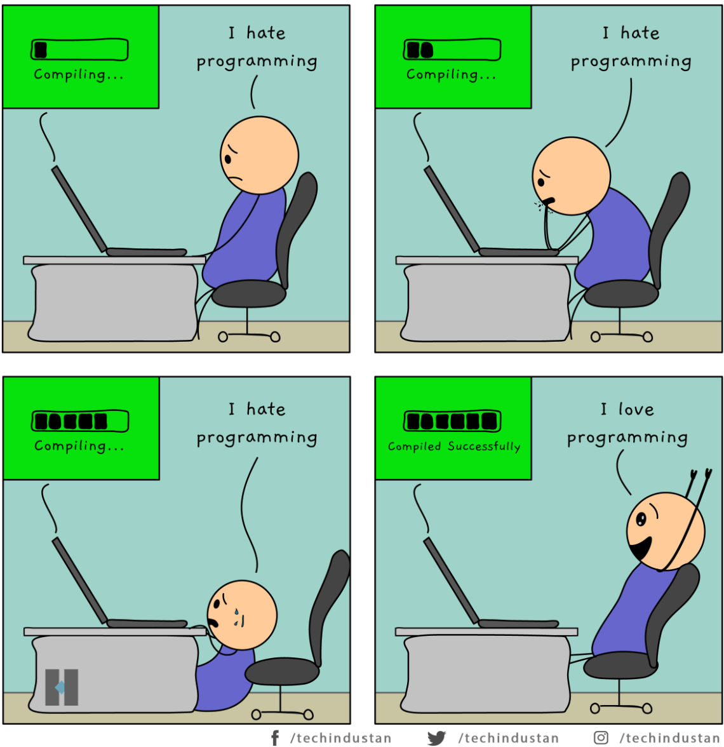
Why Are We Here?
Placeholder

Slide 4
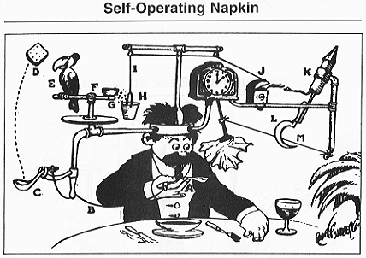
What Makes a Good Tool?

Slide 5
A Good Tool – The Philosophy of Incredibuild
Solve A Problem
Simple To Use
Flexible Integration
Development Acceleration Platform
Go Fast...
Accelerate development cycles
Single Binary…
Consume existing infrastructure
Seamless…
Agnostic consumption
Compilation
Shader / Render / VFX
Tests (e.g Unit)
Static Code Analysis
CI / CD
Manage Centrally
Visualizations
No Parrots required!
On-prem / Cloud
Your tools/process/method
No replication of environment

Slide 6
Dev Acceleration Platform – How’s It Work?
Process Virtualization
Incredibuild Sandbox
Helper Machine
Initiating Machine
Environment Stucture
INCREDIBUILD AGENT
File.cpp
INCREDIBUILD AGENT
INCREDIBUILD AGENT
File.cpp
Helper Cache
Visual Studio
Build Cache
cl.exe
Incredibuild Virtualization
Incredibuild Virtualization
O.S.
File.cpp
O.S.

Slide 7
Dev Acceleration Platform – Core…Stand Along To Blazing Fast
Dev Machine
Initiator – the machine kicking off the build
COORDINATOR
INITIATOR
Initiator communicates to Coordinator
Dev process
Available helpers are assigned from the grid
On prem laptops, desktops
On prem servers, VMS, containers
Cloud instances
Process is distributed in parallel
Heterogeneous compute – run on physical servers, laptops, desktops, VMs
HELPER
HELPER
HELPER
Automatically handles failure of resource
DYNAMICALLY MANAGED RESOURCE POOL

Slide 8
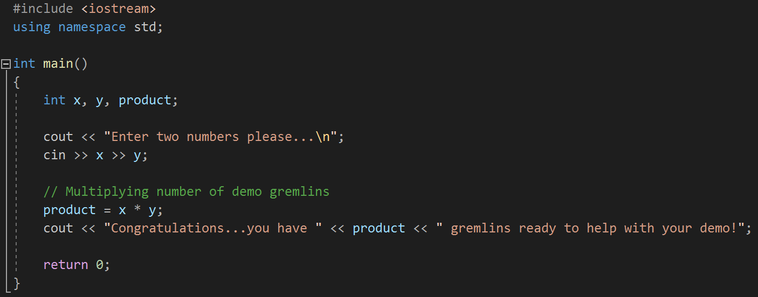
Talk Is Cheap…Show Me The Code! – Linus Torvalds
Demo Core – Stand Alone Grid
Initiator / Helper
Helper
Coordinator /
Helper
Helper
Helper

Slide 9
Dev Acceleration Platform – Flying Fast In The Cloud…The Incredibuild Cloud
Cloud instances
On prem laptops, desktops
VPC / VNET
Allocate a pool of needed capacity
HELPERS
HELPER POOL
Contain costs by utilizing spot instances
Incredibuild Cloud Orchestration Service
Burst when needed - autoscale based on compute core requirements
Incredibuild Cloud Helpers
Orchestration service manges automation
COORDINATOR
Once configured automation will handle all elements of requests – deploy, hibernate, maintain pool, deallocation
General Purpose VMs
Developer Debbie
Supports all three major cloud providers
AWS, Azure, GCP
CI Build Farm
Developer VDI
Cloud Service Provider

Slide 10
Dev Acceleration Platform – CI/SpeeD With GitHub Actions
Developer Dan
Build triggered by automation
INITIATOR
Triggers are defined by your needs
Workflow defines your job and steps to build
Actions utilizes Incredibuild command line to initiate the processing
COORDINATOR
Can be consumed by GitHub hosted or self-hosted runners
Dev process
No additional requirements or environment configurations
On prem laptops, desktops
On prem servers, VMS, containers
Cloud instances
HELPER
HELPER
HELPER
DYNAMICALLY MANAGED RESOURCE POOL

Slide 11
Talk Is Cheap…Show Me The Code! – Linus Torvalds
Demo CI/CD – GitHub Actions With Incredibuild Cloud Grid
Initiator / Helper
Helper
Coordinator /
Helper
Helper
Helper
Incredibuild Cloud Orchestration Service
Spot
Helper
Spot
Helper
Spot
Helper

Slide 12
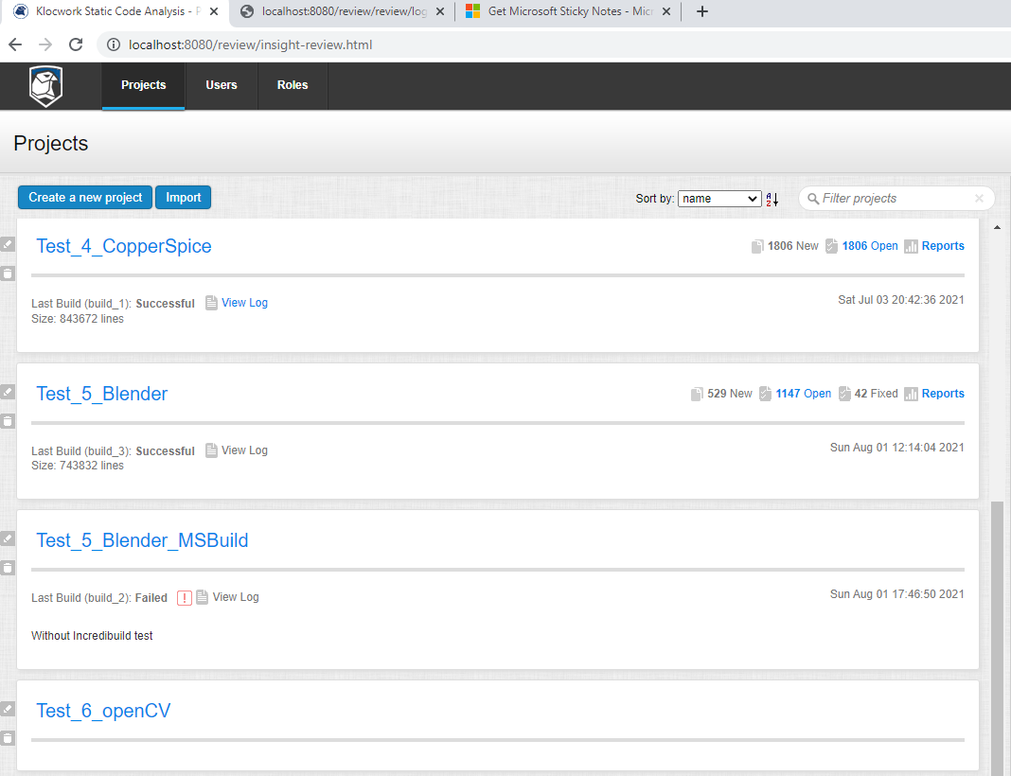
Dev Acceleration Platform – Tick Tock Your Kloc (Static Code Analysis)
Developer Dan
On prem servers, VMS, containers
Dev Machine
kwinject –o OpenCVbuildspec.out buildconsole OpenCv.sln /rebuild /cfg=“Debug|x64”
1
Software Development Lifecyle
2
xgConsole /profile=“C:\Klocwork\Server 21.1\config\xgProfile.xml” /title=“OpenCVbuildspec1” /command=“kwbuildproject --url http://localhost:8080/opencv -j 200 -o kwtables –f ”
COORDINATOR
INITIATOR
Analysis
Plan
Design
Implement
Test / Integrate
Deploy /
Maintain
On prem laptops, desktops
On prem servers, VMS, containers
Cloud instances
Klocwork build completed and generates output file:
OpenCVbuildspec.out
Analysis completed and loaded to Klocwork for review
HELPER
HELPER
HELPER
DYNAMICALLY MANAGED RESOURCE POOL

Slide 13
Talk Is Cheap…Show Me The Code! – Linus Torvalds
Demo Klocwork – Static Code Analysis
Initiator / Helper
Helper
Coordinator /
Helper
Helper
Helper
Incredibuild Cloud Orchestration Service
Spot
Helper
Spot
Helper
Spot
Helper

Slide 14
Incredibuild Summary
Solve A Problem
Simple To Use
Flexible Integration
Go Fast...
Accelerate development cycles
Single Binary…
Consume existing infrastructure
Seamless…
Agnostic consumption
Compilation
Shader / Render / VFX
Tests (e.g Unit)
Static Code Analysis
CI / CD
Manage Centrally
Visualizations
No Parrots required!
On-prem / Cloud
Your tools/process/method
No replication of environment

Slide 15
std::string incrediBuild(“Development Never Stops”);

