Slide 2
Snapchat for Desktop web
It shares a lot of the same C++ code written for the Snapchat mobile apps.
The tool we use to bind the C++ code to TypeScript is the same one we use for iOS and Android: Djinni

Slide 3
What is Djinni
Djinni Codegen
Tool
Djinni IDL
Djinni is a project originally created by Dropbox that generates bridging code between C++ and other programming languages.
It consists of
An interface definition language (IDL)
A code generator
A small support library
The original version of Djinni supports interfacing C++ with Objective-C (for iOS) and Java (for Android).
Djinni Generated files
Platform specific code
Mobile App
Djinni support library
Portable C++ code

Slide 4
A Brief History of Djinni at Snap
Snap has been using Djinni since 2016.
In 2018 Dropbox stopped developing Djinni.
We developed our own version based on the original. Lots of stability and performance improvements, and many new features are added to our version over the years.
We open sourced our version in 2021 on Github: https://github.com/snapchat/djinni
The Web Assembly support we developed for the Snapchat web app is the latest new feature.

Slide 5
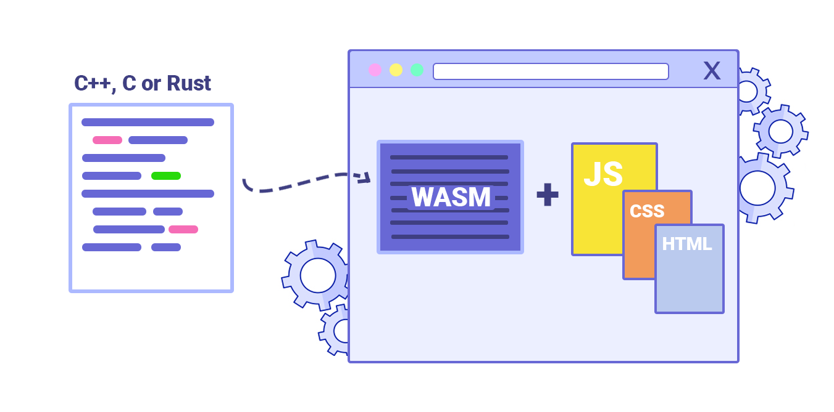
Web Assembly
WebAssembly is a new type of code that can be run in modern web browsers and provides new features and major gains in performance.
It is not primarily intended to be written by hand, rather it is designed to be an effective compilation target for source languages like C, C++, Rust, etc.
The focus of this work though, is about reusing our existing C++ code.

Slide 6
Why did we build our own wasm binding tool
Snap has a large C++ code base that is already bridged to our mobile apps through Djinni. Having Djinni support wasm means we get to reuse both our interfaces and our implementation code.
The dev teams are already familiar with using Djinni on other platforms. Giving them the same tool means very little learning is required.
The alternatives have some limitations that made them not viable for our use case.

Slide 7
Compare to the alternatives
The two C++ binding tools recommended on the Emscripten(the C++ WebAssembly toolchain) website are WebIDL binder and Embind.
WebIDL binder is a simpler tool than Embind and Djinni. It uses an interface definition language (WebIDL) to define the binding between C++ and Javascript.
Embind uses C++ code to define the interfaces. It is feature rich and supports lots of C++ constructs.
Djinni's Web Assembly feature uses Embind internally. We currently use Embind to forward method calls and perform the marshalling of primitive types.

Slide 8
Same Code for Web Apps and Mobile Apps
The biggest reason to use Djinni over Embind and other tools is that it supports Web browser, Android, and iOS at the same time.
This allowed Snapchat to take our existing mobile C++ code written for Android and iOS, and bring it into our web apps with very little change.
Compare to the alternatives

Slide 9
TypeScript Interface Output
Djinni generates TypeScript interface definitions along with Javascript bindings.
TypeScript interface gives us static error checking and enhanced IDE support.
The generated interface also differentiates nullable and non-null types.
As C++ developers we can all appreciate the value of strict typing.
Compare to the alternatives

Slide 10
Better Support for C++ Containers
Djinni translates C++ vectors, sets and maps to Javascript's built-in arrays sets and maps.
const strs: string[] = cppObj.getStrings();
With Embind they are translated to wrappers to C++ types rather than native JS containers.
// What is the type? var vec = cppObj.getStrings(); // Getting value from vector var e = vec.get(1);
WebIDL binder does not translate containers automatically.
Compare to the alternatives

Slide 11
Implementing Interfaces in JS/TS
Implementing Djinni interfaces in JS/TS is at class level and very natural:
class ClientInterfaceImpl implements test.ClientInterface { returnStr() { return "test"; } }
In Embind, it has to be done at per object level:
var x =
{ returnStr: function() { return "test"; } }; var o =
Module.test.ClientInterface.implement(x);
Compare to the alternatives

Slide 12
Asynchronous Methods
Djinni allows you to define async methods by passing future<> types.
Djinni:
get_async_result(): future<i32>;
C++:
djinni::Promise<int32_t> pr; …
djinni::Future<int32_t> Test::get_async_result() { return pr.getFuture(); } /* later: pr.setValue(42); */
TypeScript:
const r = await o.getAsyncResult();
Compare to the alternatives

Slide 13
Building Web Apps with Djinni

Slide 14
Djinni Workflow
Create Djinni IDL files
Define interfaces and their methods
Define user data types (records and enums)
Invoke the code generator
Djinni has a lot of command line options so we would typically create a shell script “run_djinni.sh”
Compile the code
Platform specific code
Portable C++ code
Djinni generated code
C++ Support library

Slide 15
Djinni IDL basics
# An interface that will be implemented in C++
# Interfaces have reference semantics my_interface = interface +c { # Instance method foo(pos: position): color; # Static factory method, the entry point static create(): my_interface; }
# A record with two 32-bit integer fields
# Records have value semantics position = record { x: i32; y: i32; } # An enum with 3 values color = enum { red; green; blue; }

Slide 16
Djinni Primitive Types
Djinni Type | Javascript Type | C++ Type
bool | bool | bool
i8, i16, i32, f32, f64 | Number | int8/16/32_t, float, double
i64 | Bigint | int64_t
string | string | std::string
binary | Uint8Array | std::vector<uint8_t>
Date | Date | std::chrono::system_clock::time_point

Slide 17
Djinni Composite Types
Djinni Type | Javascript Type | C++ Type
list<T> | Array | std::vector<>
set<T> | Set | std::unordered_set<>
map<T> | Map | std::unordered_map<>
optional<T> | T or undefined | std::optional<>

Slide 18
Let’s try it out!

Slide 19
[Live demo] Turn a mobile app to a web app
Use Djinni to generate code for Wasm/TS from the same IDL
Compile C++ code files with emcc into a .wasm file and a .js helper file
Create HTML page and JS/TS code
[Optional] Compile TS code into JS
[Optional] Bundle JS code
Run the web app!

Slide 20
Under The Hood

Slide 21
The Design Philosophy of Djinni/Wasm
Prioritize developer productivity:
Portable C++ implementation code should work across all platforms.
JS/TS user code should resemble Java/ObjC code on Android and iOS.
Use JS native types as much as possible.
Feature parity with Android and iOS.

Slide 22
Crossing the WebAssembly/Javascript boundary
Web Assembly functions can be called directly from Javascript, however
The only data type they can directly exchange is just simple numbers
The address space of the C++ module is an `ArrayBuffer` in Javascript. It is accessible from Javascript as `Module.HEAPU32` for example as 32-bit words.
In order to pass other types of data we can
Pass the address of C++ data as a number, and then access the C++ memory space from JS
Assign a numerical token to the data, and pass the token
We currently use embind to pass basic data types
Numbers
Strings (Embind handles C++ memory access for us)
Opaque objects (through the `emscripten::val` C++ type, Embind assigns a token to the object)

Slide 23
C++ Objects in Javascript
C++ Impl Object
User JS/TS Code
std::shared_ptr<>
CppProxy
Djinni generates CppProxy objects that forward method calls to C++ objects. C++ objects are managed with shared_ptr<> so releasing them in C++ code does not invalidate your reference in JS/TS code.

Slide 24
Automatic Memory Management
When JS owned proxy expires, the shared_ptr<> is automatically released.
C++ Object
User JS/TS Code
std::shared_ptr<>
CppProxy
FinalizationRegistry
Release

Slide 25
Retaining Object Identity
The same C++ object always returns to JS as the same proxy.
C++ Object
User JS/TS Code
std::shared_ptr<>
CppProxy
FinalizationRegistry
CppProxyCache

Slide 26
Javascript Objects in C++
Proxy contains generated methods that forwards calls to JS
C++ User Code
std::shared_ptr<>
JsProxy
JS/TS Object
The same JS object always returns as the same proxy too
JsProxyCache

Slide 27
Marshalling Data Across the Language Boundary
Djinni data marshalling protocol:
struct MarshallingHelperClass { using CppType = ...; using JsType = ...; static CppType toCpp(JsType x){return ...;} static JsType fromCpp(CppType x){return ...;} using Boxed = ...; };
Djinni C++ support lib provides marshallers for built-in primitive types and composite types.
Djinni code generator generates marshallers for user defined types, which ultimately calls built-in marshallers to perform the conversion.
The Boxed type points to another marshaller, which will be used when the data has to be converted to an object.

Slide 28
Exception Handling
Throwing C++ exceptions into JS
All C++ implementation methods are called in a try/catch block
Exceptions are converted to JS Error object and then thrown to the Javascript side
The original C++ exception pointer is stored in the JS Error object
If the exception was originally a wrapped JS Error, unwrap it and throw the original Error object to the Javascript side
Throwing JS exceptions into C++
All JS implementation methods are called through a JS helper method, which turns JS exceptions into Error objects and return them to C++.
If an Error object is detected, they are converted to a C++ JsException and thrown.
If the Error has a stored C++ exception pointer, retrieve the pointer and throw it.

Slide 29
Limitations
Javascript does not support overriding the default comparison and hash operation on user defined types. Therefore Djinni cannot automatically generate these methods for user defined types.
And because of the above, user defined types cannot be used as map keys.
There is no multi-threading. Web Assembly itself can support threads with web workers, but Embind currently does not work well across threads.
Requires relatively recent versions of browsers to run.

Slide 30
TL;DR
Djinni can bind your C++ code to browser apps as well as mobile apps.
Djinni's TypeScript output make consuming the binding easy and safe.
Djinni is free and open source on github, and it is actively developed and maintained by Snap.
https://github.com/Snapchat/djinni/

