Slide 2
Credit to my advisor Guy Blelloch and collaborator Hao Wei
Daniel Anderson
PhD student
danielanderson.net

Slide 3
Introduction
Quick review: Smart pointers
The concurrent memory management problem
Existing memory management techniques
Atomic smart pointers
Hazard pointers and Read-Copy-Update (RCU)
The best of both worlds?
Combining RAII + deferred reclamation
Shared pointers with deferred reclamation
An efficient library implementation

Slide 4
Introduction
Quick review: Smart pointers
The concurrent memory management problem
Existing memory management techniques
Atomic smart pointers
Hazard pointers and Read-Copy-Update (RCU)
The best of both worlds?
Combining RAII + deferred reclamation
Shared pointers with deferred reclamation
An efficient library implementation

Slide 5
Quick review: Smart pointers
Pointer type | Description
std::unique_ptr | Manages a resource with exclusive ownership Move-only. Not copyable
std::shared_ptr | Manages a resource with shared ownership Effectively requires reference counting
std::weak_ptr | A non-owning reference to a shared resource
Pointer type | Description
std::unique_ptr | Manages a resource with exclusive ownership Move-only. Not copyable
std::shared_ptr | Manages a resource with shared ownership Effectively requires reference counting
std::weak_ptr | A non-owning reference to a shared resource
std::shared_ptr | Manages a resource with shared ownership Effectively requires reference counting

Slide 6
The concurrent memory management problem
A next
B next
C next
Thread 1
Thread 2

Slide 7
The concurrent memory management problem
A thread might want to delete something that another thread is still reading

Slide 8
Goals of this talk
Understand existing solutions: atomic shared_ptr, and hazard pointers and RCU
Answer the question: Can we get the best of both worlds?
THIS
TALK
Hazard ptrs RCU
atomic shared_ptr
Easy to use
High performance

Slide 9
Introduction
Quick review: Smart pointers
The concurrent memory management problem
Existing memory management techniques
Atomic smart pointers
Hazard pointers and Read-Copy-Update (RCU)
The best of both worlds?
Combining RAII + deferred reclamation
Shared pointers with deferred reclamation
An efficient library implementation

Slide 10
Atomic smart pointers (since C++20)
Atomic smart pointers were introduced to answer the age-old question…

Slide 11
Atomic smart pointers (since C++20)
Thread 1 std::shared_ptr<X> s1
Thread 2 std::shared_ptr<X> s2
X x
ref_cnt:
3
2
0
1
2
auto s3 = s2;
s3 = other_thing;
Thread 3 auto s4 = s3;

Slide 12
Atomic smart pointers (since C++20)
atomic<shared_ptr>: Holds a shared_ptr that can be manipulated atomically!
void store(shared_ptr<T> desired)
shared_ptr<T> load()
bool compare_exchange_weak(shared_ptr<T>& expected, shared_ptr<T> desired)
…

Slide 13
Atomic smart pointers (since C++20)
How many lines does it take to implement a lock free & memory safe stack?
template<typename T>
struct Stack {
struct Node { T t; shared_ptr<Node> next; }; // + constructor
atomic<shared_ptr<Node>> head;
void push_front(T t) {
auto p = make_shared<Node>(std::move(t), head.load());
while (!head.compare_exchange_weak(p->next, p)) {}
}
optional<T> pop_front() {
auto p = head.load();
while (p != nullptr && !head.compare_exchange_weak(p, p->next)) { }
if (p != nullptr) return {std::move(p->t)};
else return {};
}
};

Slide 14
Atomic smart pointers (since C++20)
How many lines does it take to implement a lock free & memory safe stack?
2/3 major standard library implementations have shipped an atomic<shared_ptr>
Both are locking
Good news: Lock-free implementation is possible (see Timur’s talk)

Slide 15
Atomic smart pointers (since C++20)
Good news: Lock-free is possible
Bad news:

Slide 16
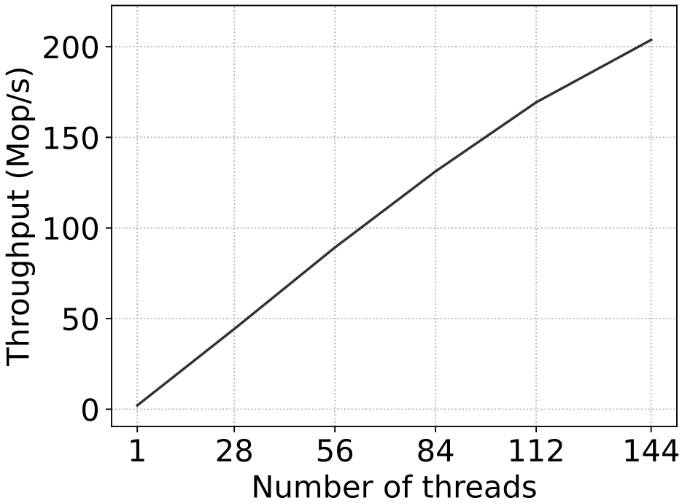
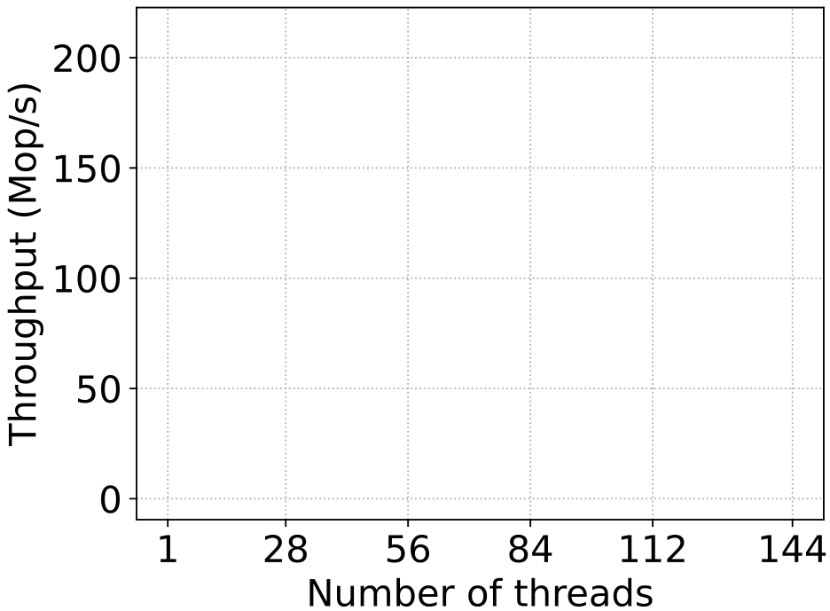
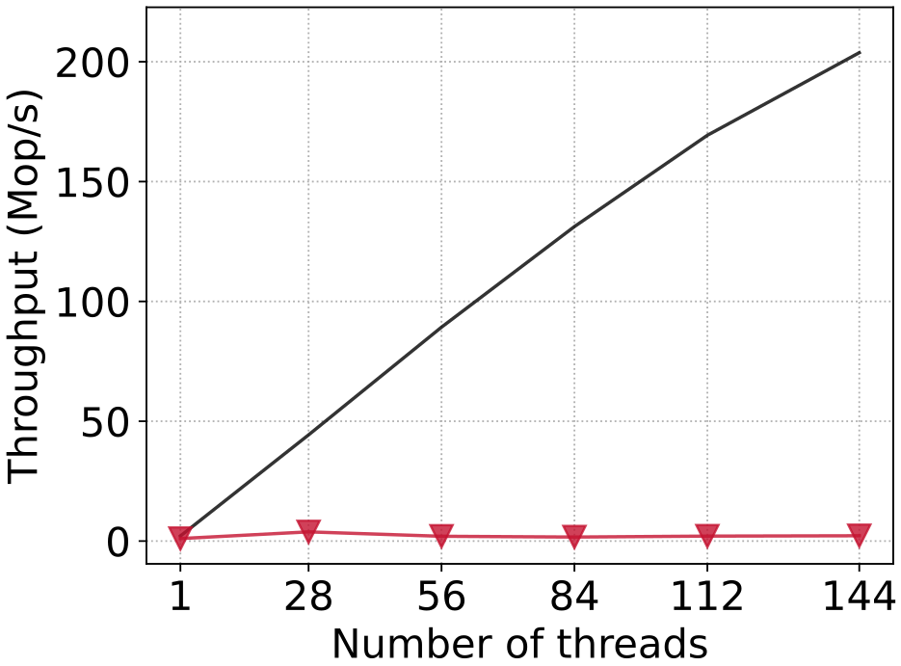
Atomic smart pointers (since C++20)
72 core machine, 1TB RAM Lock-free BST, 100K keys 99% reads, 1% updates
Baseline
atomic<SP>

Slide 17
Why are atomic shared pointers so slow??
$$r$$
$r→$ref_cnt++
$x→$ref_cnt++
$$x$$
$r→$ref_cnt--
$y→$ref_cnt++
$$y$$
$x→$ref_cnt--
$z→$ref_cnt++
$$z$$
$y→$ref_cnt--
$w→$ref_cnt++
$$w$$
$z→$ref_cnt--

Slide 18
Introduction
Quick review: Smart pointers
The concurrent memory management problem
Existing memory management techniques
Atomic smart pointers
Hazard pointers and Read-Copy-Update (RCU)
The best of both worlds?
Combining RAII + deferred reclamation
Shared pointers with deferred reclamation
An efficient library implementation

Slide 19
Another paradigm: Deferred reclamation
If someone is reading something that you want to delete, defer it until later

Slide 20
Another paradigm: Deferred reclamation
TODO: Delete this
A next
B next
C next
Boy, would I like to delete B right about now…
Someone else is reading it. I guess I’ll delete it later
Thread 1
Thread 2

Slide 21
Another paradigm: Deferred reclamation
Deferred reclamation schemes differ in:
How to determine whether something might currently be being read
How and when they perform deferred deletion (synchronously or asynchronously, same thread, different thread)
Replace delete with retire
retire: delete this object after any existing readers are finished
Usage is extremely subtle, and bugs are common

Slide 22
Hazard Pointers
Threads announce particular pointers that they plan to read (“protect”)
Periodically clean up retired objects, but defer those with an active hazard pointer Limitations/pitfalls:
Often, for searches, the operation must restart if an update touches it
This means that hazard pointers do not work with every data structure.
Traversals that require multiple hazard pointers (e.g., hand-over-hand) require the user to keep the correct ones active

Slide 23
Hazard Pointers: Performance prediction
$$r$$
Announce and read $r$
Announce and read $x$
$$x$$
Unprotect $r$
Announce and read $y$
$$y$$
Unprotect $x$
Announce and read $z$
$$z$$
Unprotect $y$
Announce and read $w$
$$w$$
Unprotect $z$

Slide 24
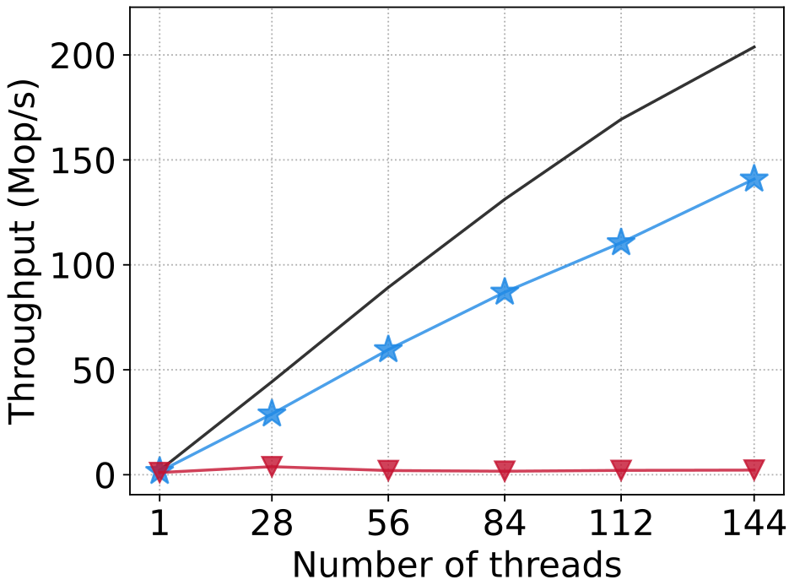
Hazard Pointers: Actual performance
72 core machine, 1TB RAM Lock-free BST, 100K keys 99% reads, 1% updates
Baseline
atomic<SP>
Hazard Ptr

Slide 25
RCU
Threads announce their intention to read the data structure
Retired objects cleaned up synchronously or asynchronously Comparison to hazard pointers
Protection is coarse grained
Throughput is higher
Memory overhead is higher
Easier to use

Slide 26
RCU: Performance prediction
$$r$$
Begin RCU reader
Read $r$
$$x$$
read $x$
read $y$
$$y$$
read $z$
read $w$
$$z$$
End RCU reader
$$w$$

Slide 27
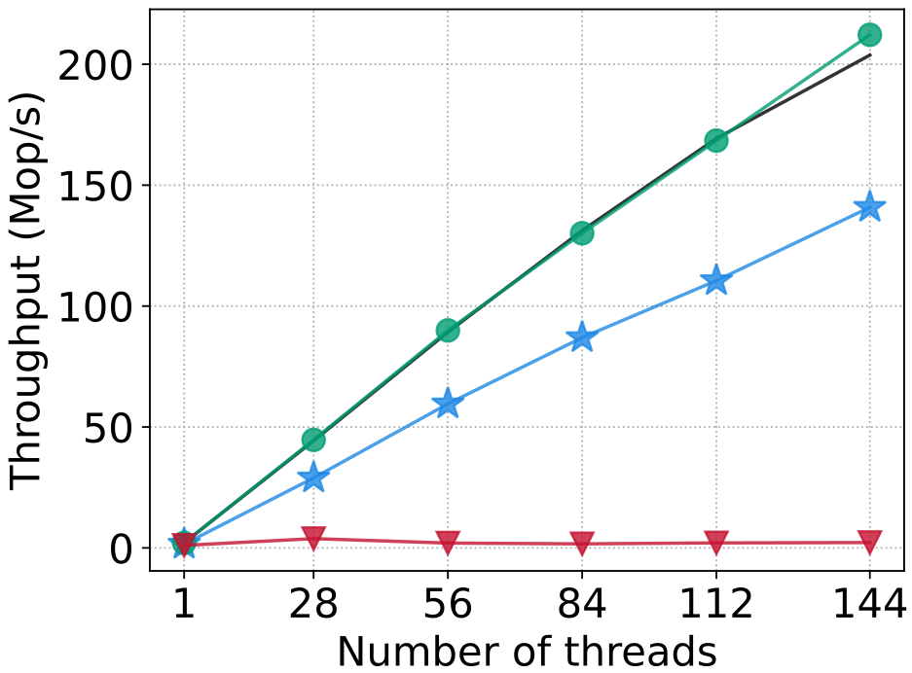
RCU: Actual performance
72 core machine, 1TB RAM Lock-free BST, 100K keys 99% reads, 1% updates
Baseline
atomic<SP>
Hazard Ptr
RCU

Slide 28
The big question: Can we get performance closer to hazard pointers and RCU with a smart pointer?

Slide 29
Introduction
Quick review: Smart pointers
The concurrent memory management problem
Existing memory management techniques
Atomic smart pointers
Hazard pointers and Read-Copy-Update (RCU)
The best of both worlds?
Combining RAII + deferred reclamation
Shared pointers with deferred reclamation
An efficient library implementation

Slide 30
Combining RAII and deferred reclamation
RAII-based ownership (i.e., smart pointers) simplify memory management
Essential for non-expert users
But many users don’t want to sacrifice performance
Deferred reclamation seems necessary for high throughput and scalability…
Can we get the best of both worlds?

Slide 31
Hasn’t this been proposed?
cell / latest / snapshot_src
Supports (roughly) the following API:
void update(unique_ptr<T> ptr)
bool try_update(const snapshot_ptr<T>& expected, unique_ptr<T>&& desired)
snapshot_ptr<T> get_snapshot()
snapshot_ptr<T> guarantees the liveness of the T without taking ownership

Slide 32
Deferred reclamation with shared ownership
We propose a similar API that manages a shared pointer
void store(shared_ptr<T> desired)
shared_ptr<T> load()
bool compare_exchange_weak(auto& expected, shared_ptr<T>&& desired)
snapshot_ptr<T> get_snapshot()
atomic
shared
pointer
Think of it like atomic<shared_ptr> + snapshot_ptr
get_snapshot() allows us to read without incrementing the reference count

Slide 33
Example: Single-writer linked list
Using hazard pointers
Using deferred smart pointers
struct Node : public hazard_pointer_obj_base<Node> { T value; atomic<Node*> next; };
atomic<Node*> head;
// Single (or synchronized) writer void remove(Node* prev, Node* target) { prev->next.store(target->next.load()); target->next.store(nullptr); target->retire(); };
struct Node { T value; deferred_shared_ptr<Node> next; };
deferred_shared_ptr<Node> head;
// Single (or synchronized) writer void remove(Node* prev, Node* target) { prev->next.store(target->next.load()); };
prev
target
next
Thanks to Maged Michael for this example code!

Slide 34
Example: Single-writer linked list
// May be called by multiple concurrent readers bool find(const T& val) { hazard_pointer hprev = make_hazard_pointer(); hazard_pointer hcur = make_hazard_pointer(); while (true) { atomic<Node*>* prev = &head_; atomic<Node*> cur = prev->load(); while (true) { if (!cur) return false; if (!hcur->try_protect(cur, *prev)) break; auto next = cur->next.load(); if (prev->load() != cur) break; if (cur->value == val) return true; swap(hcur, hprev); prev = &(cur->next); cur = next; } } }
// May be called by multiple concurrent readers bool find(const T& val) { snapshot_ptr<Node> cur = head.get_snapshot(); while (true) { if (!cur) return false; if (cur->value == val) return true; cur = cur->next.get_snapshot(); } }

Slide 35
Okay, nice interface… but can it actually be implemented efficiently?

Slide 36
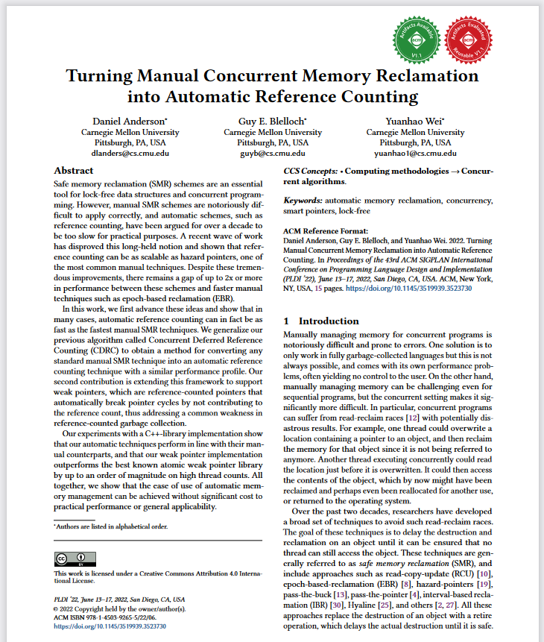
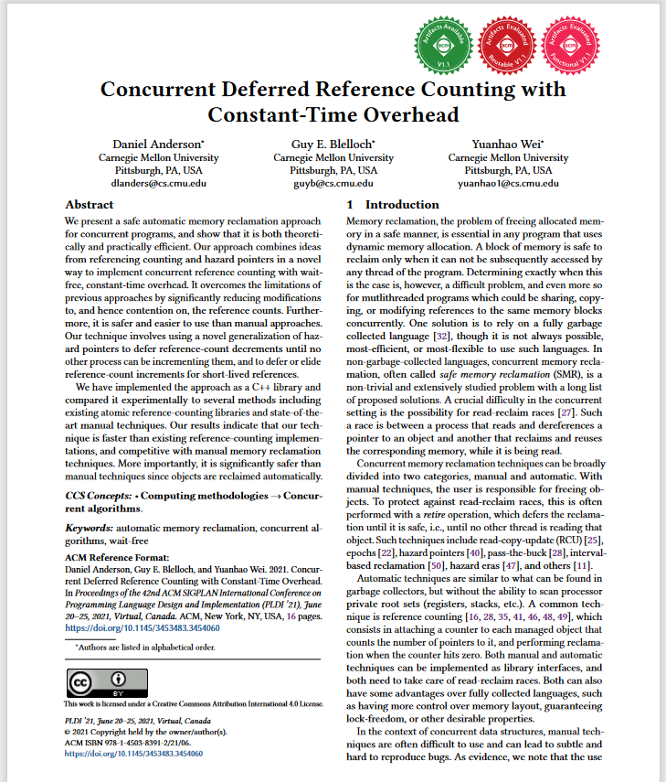
https://doi.org/10.1145/3519939.3523730
https://doi.org/10.1145/3453483.3454060

Slide 37
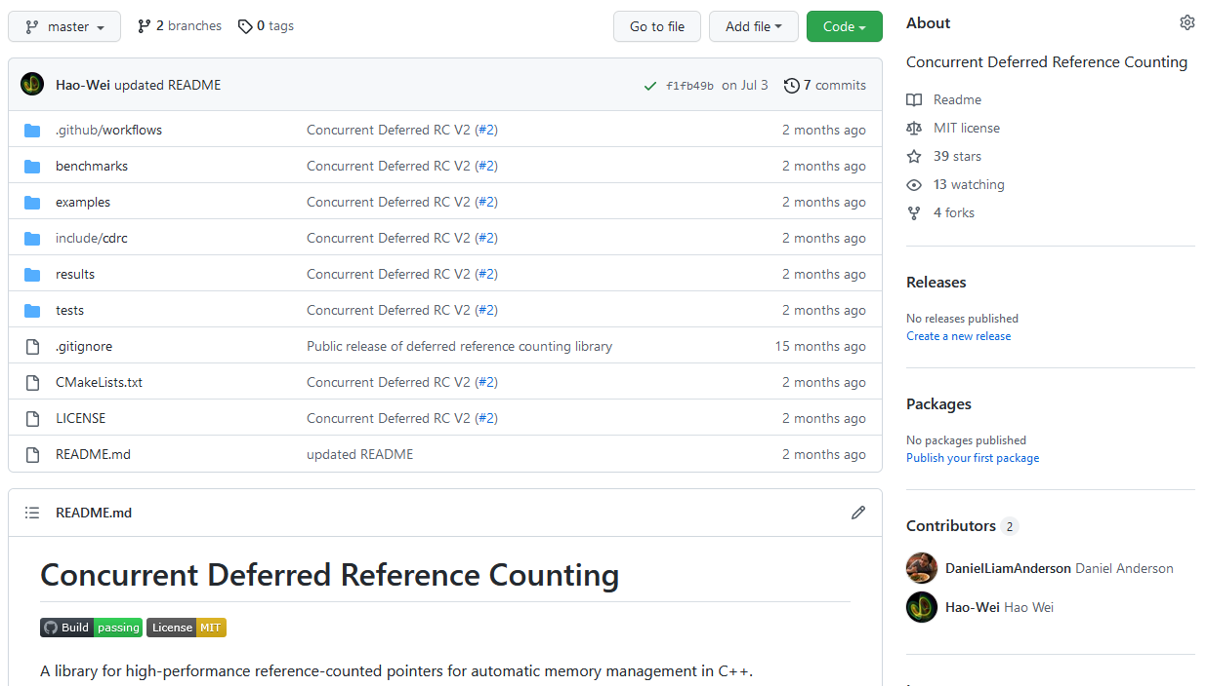
See our reference implementation
https://github.com/cmuparlay/concurrent_deferred_rc
Disclaimer: Not standard-library quality code yet. Still a research prototype

Slide 38
How does it work?

Slide 39
How does it work?
For details, read the papers (or even better, talk to me!)
Key idea: Repurpose deferred reclamation, to defer something else…
Deferred reclamation is usually used to manage the lifetime of objects
Why don’t we use it to instead manage the reference count!

Slide 40
Use deferred reclamation to defer decrements to the reference count

Slide 41
Deferred reference counting (DRC)
Under the hood:
protect(x): Prevent the reference count of $x$ from being decremented by an atomic operation
retire(x): Decrement the reference count of $x$ at some point when $x$ is not protected
Implementable using hazard pointers or RCU

Slide 42
Implementation
std::atomic<control_block*> ptr;
shared_ptr<T> load() {
// No atomic op can decrement the ref count
auto protected_ptr = protect(&ptr);
protected_ptr->increment_ref_count();
return shared_ptr<T>(protected_ptr);
} // protection is released
bool compare_exchange_weak( shared_ptr<T>& expected, shared_ptr<T>&& desired) {
control_block* exp = expected.ctrl_block();
control_block* des = desired.ctrl_block();
if (ptr.compare_exchange_strong(exp,des)) {
if (exp != nullptr) retire(exp);
desired.release();
}
else {
expected = load();
return false;
}
}
void store(shared_ptr<T> desired) {
auto new_ptr = desired.release();
auto old_ptr = ptr.exchange(new_ptr);
if (old_ptr != nullptr) retire(old_ptr);
}
snapshot_ptr<T> get_snapshot() {
auto protected_ptr = protect(&ptr);
return snapshot_ptr<T>(move(protected_ptr));
}

Slide 43
Okay… but is it fast?

Slide 44
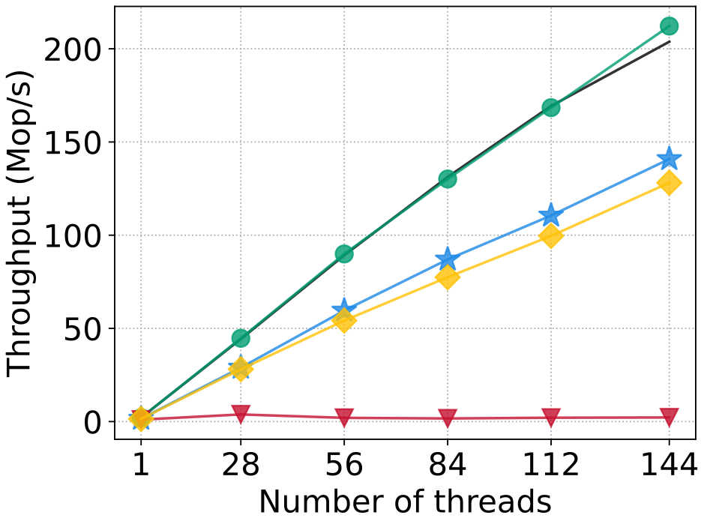
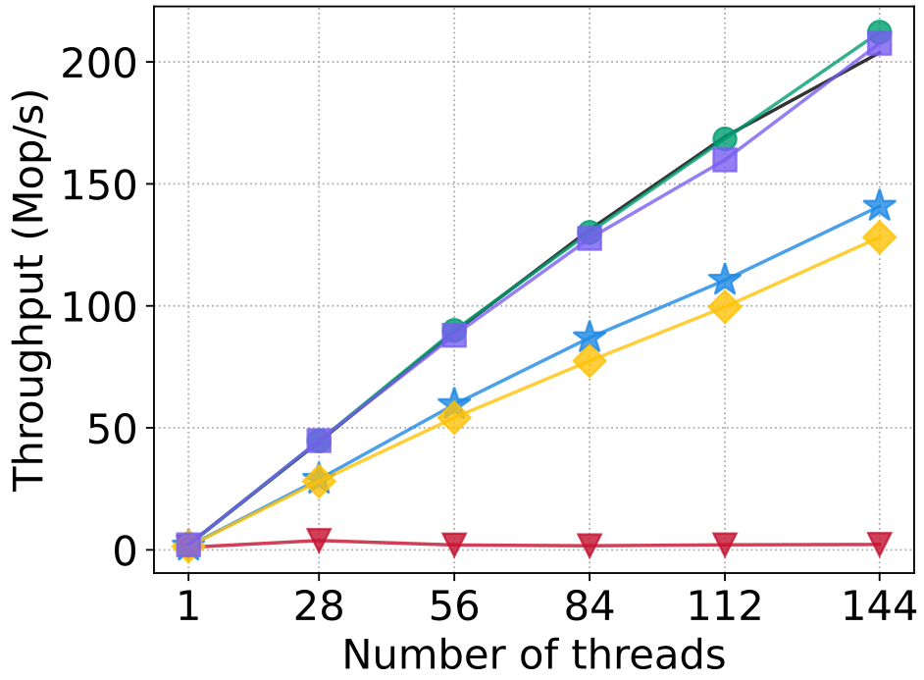
Performance test
72 core machine, 1TB RAM Lock-free BST, 100K keys 99% reads, 1% updates
Baseline
atomic<SP>
Hazard Ptr
NEW (HP)
RCU
NEW (RCU)

Slide 45
Some final remarks
Fun facts
Only single-word CAS
No bit-stealing / pointer packing
We also support weak pointers!
TODOs
Better name than deferred_shared_ptr?
Production-quality implementation
Proposal for TS / standard?

Slide 46
In conclusion
Can we get the best of both worlds?
THIS
TALK
Hazard ptrs RCU
atomic shared_ptr
Easy to use
High performance
Yes!

Slide 47
Optimized hand-over-hand traversal
// May be called by multiple concurrent readers
bool find(const T& val) {
snapshot_ptr<Node> prev = head.get_snapshot();
snapshot_ptr<Node> cur = head.get_snapshot();
while (true) {
if (!cur) return false;
if (cur->value == val) return true;
std::swap(prev, cur);
cur.reuse_protection(cur->next);
}
}

Slide 48
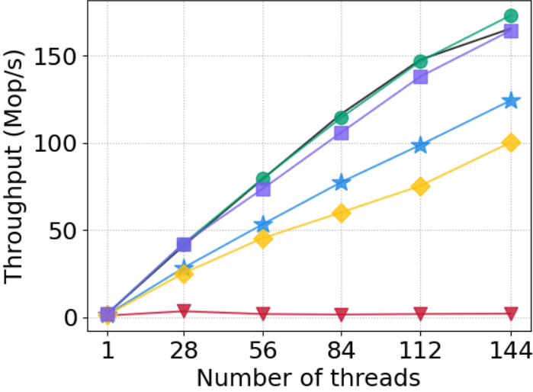
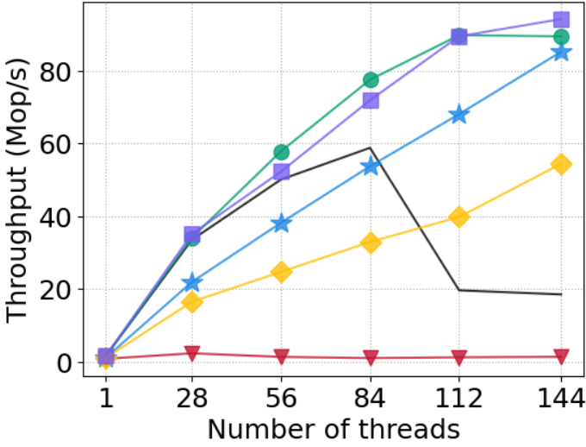
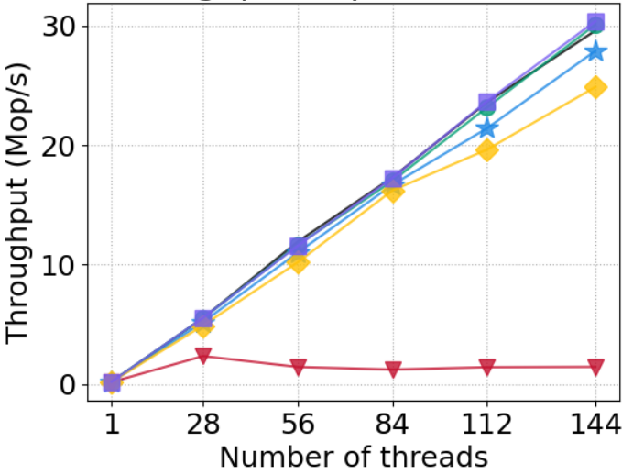
Different BST workloads
10% updates
50% updates
100M node tree
Baseline
atomic<SP>
Hazard Ptr
NEW (HP)
RCU
NEW (RCU)

Slide 49
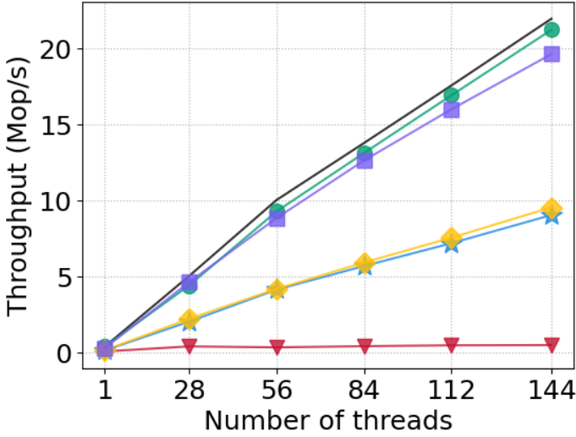
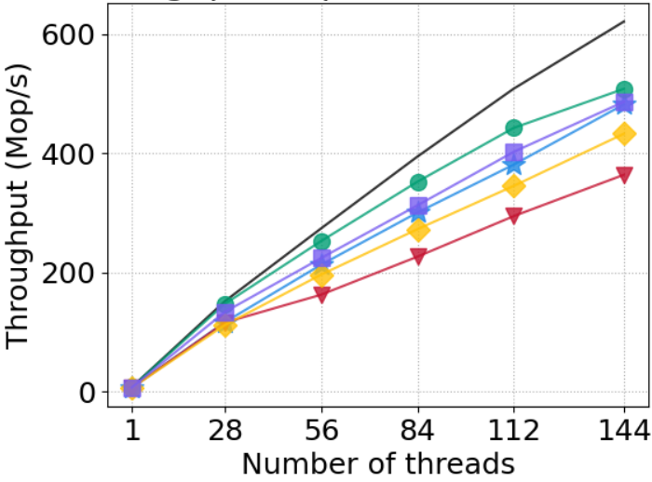
Other data structures
Linked list 1000 nodes, 90% reads
Hashtable 100k nodes, 90% reads
Baseline
atomic<SP>
Hazard Ptr
NEW (HP)
RCU
NEW (RCU)

