Slide 2
About Me
Software engineer building monitoring systems at
Passionate about C++, used throughout career
Author of the book “C++ Fundamentals” – Packt
I like writing and talking about C++
makers.f.dev@gmail.com

Slide 3
Disclaimers
Difficult to get hard data
Share tools, techniques and suggestions
Context is always relevant
Notes:
Based on experience and practices shared in the industry
Up to you to decide which one and when to use it
Different constrains call for different solutions, don’t feel like this is a must follow
But it’s a good starting point, if you don’t already have a good idea of the approach to follow

Slide 4
Outline
Dependency Injection
Types of dependencies
Passing dependencies
Abstracting Components
Notes:
Who has heard about dependency injection before?
Who’s doing it consistently in their code?
If big difference in hands - Who is doing it sometimes?

Slide 5
Dependency Injection
Notes:
What is dependency injection?

Slide 6
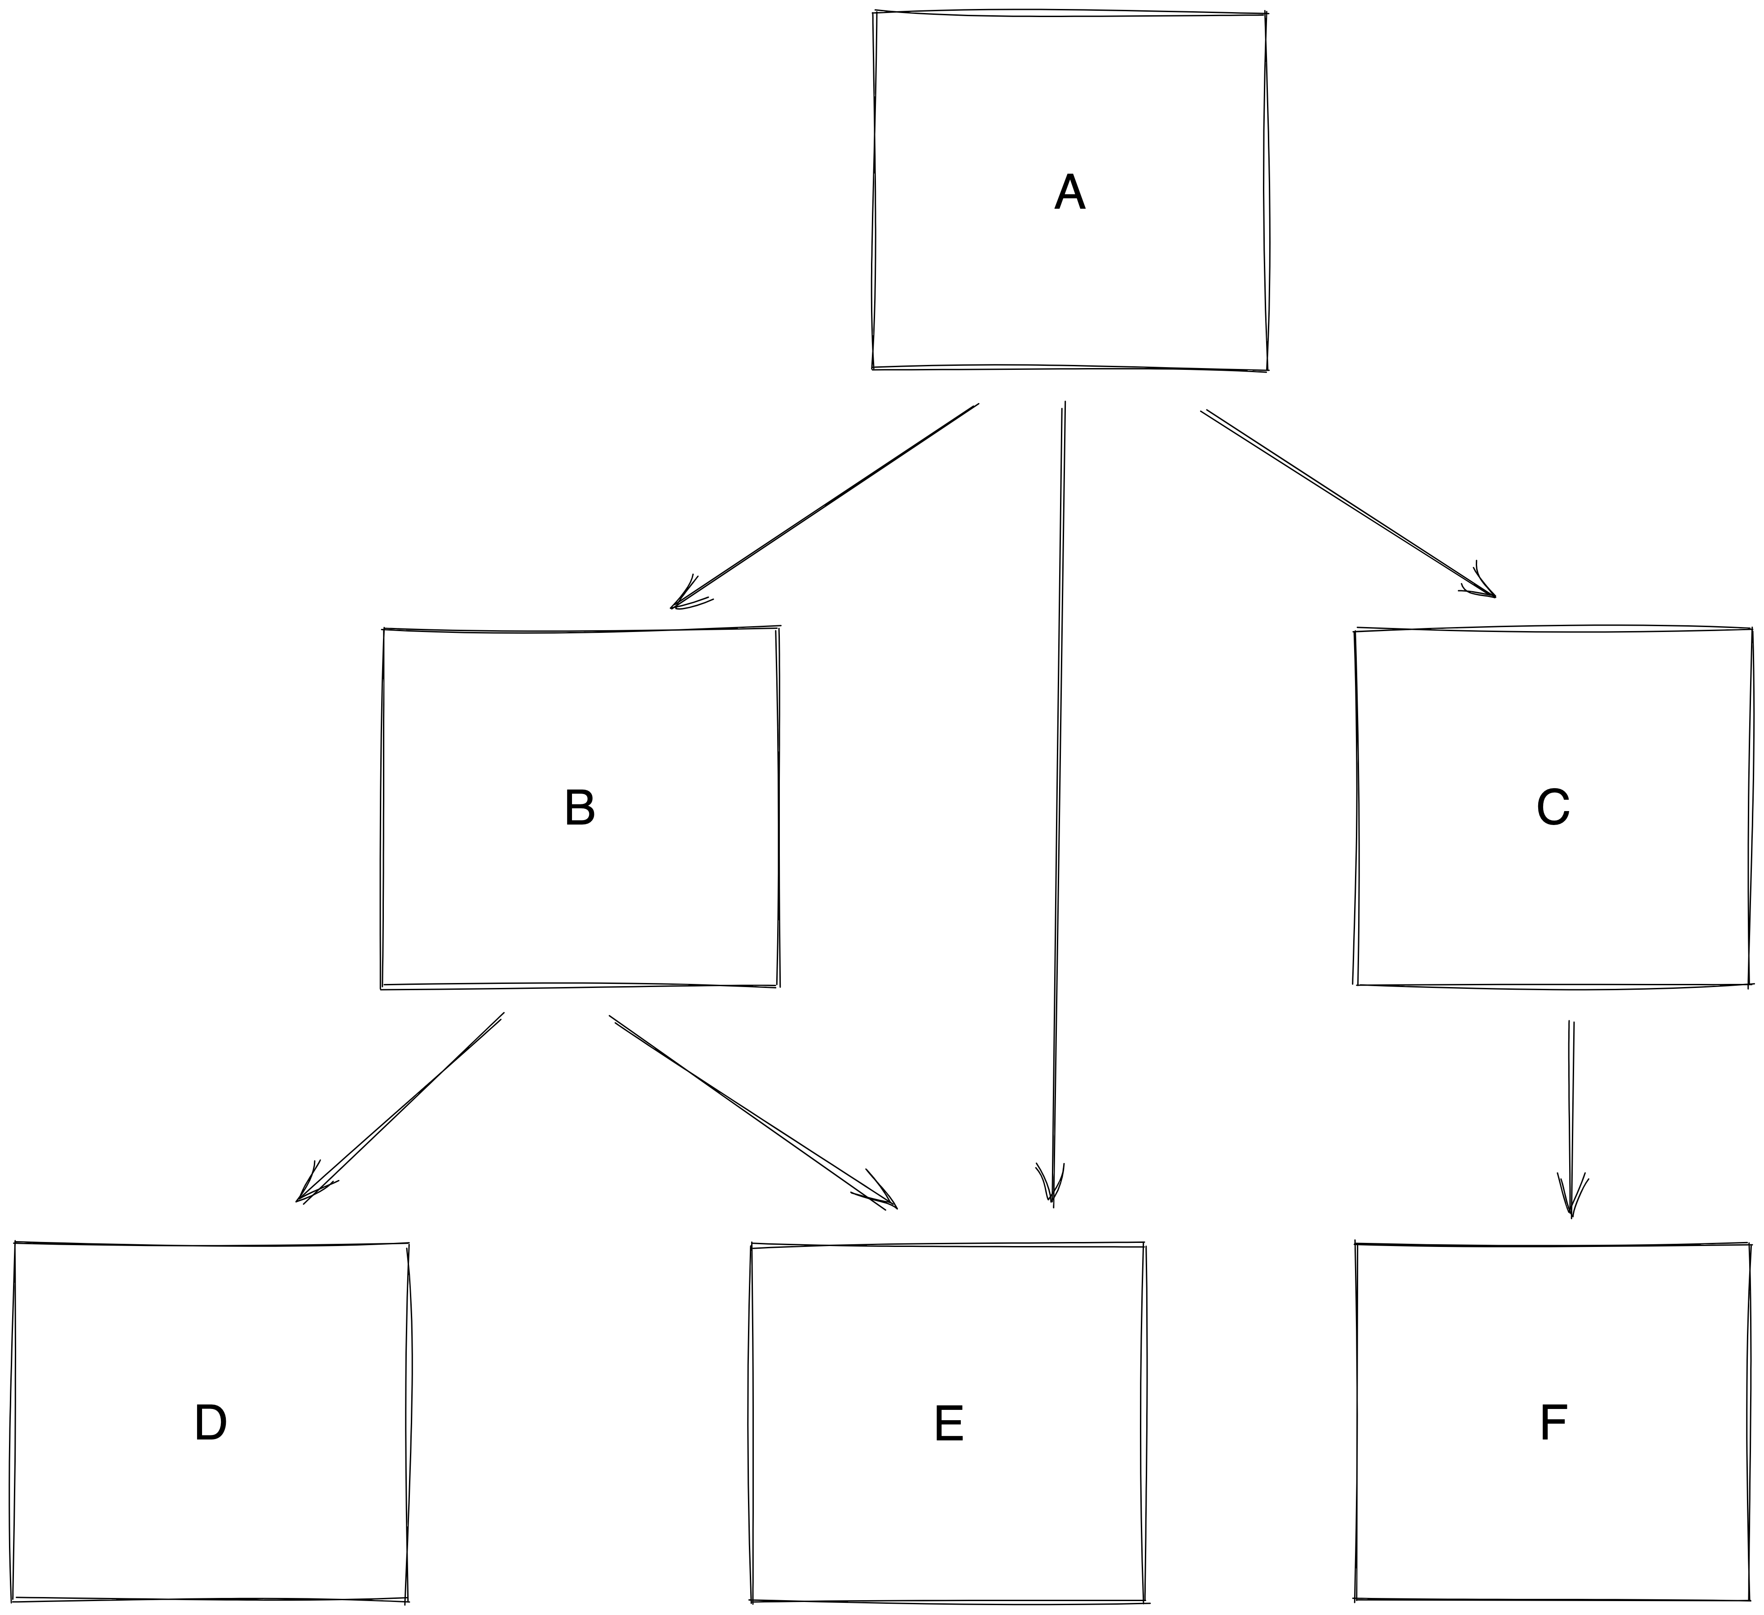
Dependency Injection
Notes:
Let’s say that your system is composed by multiple components
And the components interact with each other

Slide 7
Dependency Injection
Observable behaviour
Intended interface
Usage
User
Implementation
Notes:
The components should interact through an interface
Interface means a clear contract on the pre-conditions (what must be true when calling the implementation) and post-conditions (what will be true after the call is done).
An implementation might have other observable behaviours, but the user shouldn’t rely on them.
Instead, it should rely on just the contract provided by the interface

Slide 8
Dependency Injection
Implementation 1
Interface
User
Implementation 2
Notes:
There might be multiple implementations for an interface.
Which one should the component use?
The core of dependency injection is that component shouldn’t care, and instead should work with any implementation that is provided to it.
How?

Slide 9
Dependency Injection
Inject the implementation
implementation: implement interface
user: expects interface
higher level: decide which implementation

Slide 10
Dependency Injection
Never instantiate your own dependency
dependencies should be passed as parameters
Notes:
Instantiating an object means knowing the concrete type -> you’re not programming against the interface anymore
All the dependencies should be passed as parameter. Dependencies must be explicit.

Slide 11
Dependency Injection
Notes:
We should end up with a structure as above

Slide 12
Dependency Injection
Notes:
Some code needs to instantiate and wire the dependencies.
We’ll see how to do that

Slide 13
Dependency Injection
Notes:
It’s simple to validate the correctness of the component.
Look at the code of the component and the contract the interfaces it uses provide.
Check that the behavior is compatible with what the interface it implements specifies

Slide 14
Dependencies
Notes:
Let’s say you defined your interface (which means you set on the pre and post conditions).
How should this interface be passed around?

Slide 15
Dependencies
How dependency is passed imposes constraints
on user
on component
void foo(shared_ptr<Dependency> dep);
void bar(Dependency& dep);
Notes:
As shared_ptr, forces the allocation. But can store it
As reference, less options for the implementation

Slide 16
Dependencies
Should
impose all required constraints
and no more

Slide 17
Dependencies
Don’t force the method of lifetime management of the dependency
take the dependency as a reference
no smart pointers
Notes:
The owner of the component is responsible to ensure the dependency outlives the component
the component would be forcing the lifetime management of the dependencies to its owner
Let’s see how this works in practice

Slide 18
Types of Dependencies

Slide 19
Types of Dependencies
Data
Dependency on some information
Behaviors
Dependency on some action

Slide 20
Data

Slide 21
Data
Data must always be read-only
avoid action at a distance

Slide 22
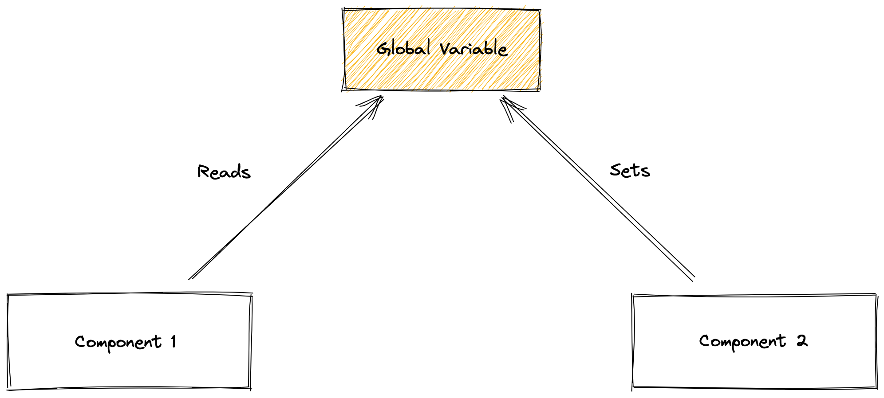
Data
Action at a distance
Notes:
Ties together components which are not explicitly depending on each other

Slide 23
Data
Constant
Might change
Notes:
Note how they are defined: these are constraints.
The constrain is imposed by the interface, since the implementation needs to be different for the 2 cases.

Slide 24
Data
The shape is the interface
Use value-types
Prefer making it explicit
structured types
schematized types
Notes:
No json!! It would make the interface implicit

Slide 25
Data
The shape is the interface
concrete type (std::vector)
performance: 5/5
freedom of caller: 1/5
view objects (std::span)
performance: 5/5
freedom of caller: 2/5 (only contiguous)
polymorphic object (any_range)
performance: 1/5
freedom of caller: 5/5
vector -> vector ✓
array -> vector ✗
set -> vector ✗
vector -> span ✓
array -> span ✓
set -> span ✗
vector -> any_range ✓
array -> any_range ✓
set -> any_range ✓
Notes:
Common theme: most generic -> higher cost.
When you have a complex structure, concrete and polymorphic compose well, view doesn’t (e.g. span<span> not compatible with vector<vector>)
Using the concrete type often is the easiest choice.
An option is template

Slide 26
Data - Constant

Slide 27
Data - Constant
Use const &
The data MUST not be changed for the duration of the component
surprising when a const& changes value
UB if done by different threads
using Identifiers = vector<Identifier>;
void do_stuff(const Identifiers& ids);

Slide 28
Data - Constant
Use case
Hard coded parameters
Parameters from cli flags
Should be preferred way

Slide 29
Data – Might Change

Slide 30
Data – Might Change
Still read only!

Slide 31
Data – Might Change
Make it clear
std::atomic_ref<const T>
copies for each access
const folly::Synchronized<T>&
lock for access (risk contention)
folly::Observer<T>
no lock, exposes snapshots (decouples contention, higher cost)
Notes:
Contract: support data modificabile da piu thread

Slide 32
Synchronized
Synchronized<int> sync = 1;
{
auto wGuard = sync.wlock();
int& val = *wGuard;
}
{
auto rGuard = sync.rlock();
const int& val = *rGuard;
}

Slide 33
Observer
Observer<int> observer = …;
Snapshot<int> snapshot = *observer;
const int& value = *snapshot;

Slide 34
Observer
Observer<int> sumObserver = makeObserver(
[observerA, observerB] {
int a = **observerA;
int b = **observerB;
return a + b;
});

Slide 35
Observer
SimpleObservable<int> observable = 10;
observable.setValue(15);
Observer<int> observer =
observable.getObserver();

Slide 36
Observer
Allows multiple “views” on the data

Slide 37
Observer
SimpleObservable<ProgramConfig> configSource =
parseConfig(readFile(path));
FileWatcher watcher(path, [&]() {
configSource.setValue(parseConfig(readFile(path)));
});
Observer<ProgramConfig> config =
configSource.getObserver();
Notes:
FileWatcher is an invented API

Slide 38
Observer
Observer<ComponentA> configA = makeObservable(
[configSource]() {
return (**configSource).componentAConfig();
});
Observer<ComponentB> configB = makeObservable(
[configSource]() {
return (**configSource).componentBConfig();
});

Slide 39
Data – Might Change
Advantages:
Trivial tests: can simply pass a (wrapped) value
Changing source of data is trivial
decoupled the producer and the consumer(s))
Notes:
Note: testing behavior when data changes is very complex.
The suggestion I’d give is to get a snapshot of the data at the start of processing, and from there on access the snapshot.

Slide 40
Data – Might Change
Use cases
Pushing data to component (configuration changes, regular reload of data from source)
For pull, a behavior is often best (on demand, freshness guarantees)

Slide 41
Behaviour

Slide 42
Behaviour
Stateful effect
Get data on-demand
Perform pure computation
Notes:
Stateful
Insert in a map
Schedule an operation
Send request to a service
Get data
Access data in local state
Fetch from DB
Read from disk
Computation
Compute price of item applying several rules

Slide 43
Behaviour
Single action
Bundle of actions
Notes:
We always want to have explicit signatures

Slide 44
Behavior – Single action
Runtime polymorphism
std::function
std::function_ref

Slide 45
Behavior – Single action
using ConfigLoader = function<Config(ConfigPath)>;
void doStuff(ConfigLoader loader);
doStuff([](ConfigPath path) { … });

Slide 46
Behavior – Single action
Compiletime polymorphism
concept: std::invocable, std::invoke_result
Notes:
The dependency is guaranteed to outlive us, so there is no need to force the user to pass by value

Slide 47
Behavior – Single action
template<class T>
concept ConfigLoader =
invocable<T, ConfigPath> &&
same_as<Config, invoke_result_t<T, ConfigPath>>;
void doStuff(ConfigLoader auto&& loader);
doStuff([](ConfigPath path) { … });

Slide 48
Behavior - Bundle
Runtime - Abstract Base Class
class ISender {
virtual ~ISender() = default;
virtual Receipt sendWithPriority(Package) = 0;
virtual Receipt sendCheapest(Package) = 0;
};

Slide 49
Behavior - Bundle
Runtime - Abstract Base Class
Avoid: concrete base class!
constructor runs even when mocked

Slide 50
Behavior - Bundle
Static – Concept
template<class Sender>
concept ISender = requires (Sender& s, Package p) {
{ s.sendWithPriority(p) } -> same_as<Receipt>;
{ s.sendCheapest(p) } -> same_as<Receipt>;
};

Slide 51
Behavior - Bundle
Static – Concept
class MockSender {
MOCK_METHOD(Receipt, sendWithPriority, (Package), ());
MOCK_METHOD(Receipt, sendCheapest, (Package), ());
};
static_assert(ISender<MockSender>);
Notes:
Mocking: same as ABC
You can use MOCK_METHOD exactly like if you were mocking an ABC, simply you don’t inherit from any interface.

Slide 52
Behavior - Summary
 | Runtime Polymorphism | Static Polymorphism
Single Action | std::function std::function_ref | Concept
Bundle | Abstract Base Class | Concept

Slide 53
Behaviour - Optional
Sometimes dependencies are optional
Try to make them not optional
Notes:
No-op/default behavior
Avoids branches, more linear code

Slide 54
Behaviour - Optional
Use std::optional
For single actions
Use std::observer_ptr or optional<reference_wrapper<T>>
For bundles
Avoid pointers usage in the interface
Notes:
Confusing: does it take ownership? Does it support null?
Internally you can use the pointer, as locally we can validate that is not owning

Slide 55
Dependency
Prefer a data dependency to a behavior dependency
Less ”powerful”, easier to understand
Before
void foo() {
auto data = get_data();
// Do stuff with data
continue_with(data);
}

Slide 56
Dependency
Prefer using Data over behavior
After
auto foo(auto data) {
// Do stuff with data
return data;
}
Notes:
Much easier to test
Easier to compose (potentially different follow ups, or different sources of data)
Less rabbit hole of jumping from a function to another
The function must do some interesting logic, otherwise it’s not worth to split it, since there will still be a function which gets the data, calls this, and then calls the following action

Slide 57
Passing Dependencies

Slide 58
Passing Dependencies
Passing to the constructor
Passing as argument to a function

Slide 59
Passing Dependencies
NO: setters!
They enable cycles
Confuse lifetimes
Force to handle not set
Force to handle change at runtime
ComponentA a;
ComponentB b;
a.setDependency(b);
b.setDependency(a);

Slide 60
Passing Dependencies - Constructor
class Foo {
Foo(string loggingPath) {
unique_ptr<IStorage> storage =
make_unique<FileStorage>(loggingPath);
logger_ =
make_unique<StructuredLogger>(storage);
}
unique_ptr<ILogger> logger_;
};
Notes:
Notice how Foo needs to know:
that Bar is the implementation of Ibar
that Bar has a dependency on IBaz and
that Baz implements IBaz
Bar is forced to take IBaz with a unique_ptr.

Slide 61
Passing Dependencies - Constructor
int main() {
Foo foo(“…”);
// Use foo
}
Notes:
The alternative, using DI

Slide 62
Passing Dependencies - Constructor
class Foo {
public:
Foo(ILogger& logger) : logger_(logger) {}
private:
ILogger& logger_;
};
Notes:
For next slide:
How does it compare with other common approaches I saw in production?
Let’s see

Slide 63
Passing Dependencies - Constructor
int main() {
FileStorage storage(“…”);
StructuredLogger logger(storage);
Foo foo(logger);
// Use foo
}

Slide 64
Passing Dependencies - Constructor
Decoupling
Foo doesn’t need to know anything besides contract with ILogger
Changes to FileStorage have no impact on Foo
Lifetime is automatic
Easy sharing
Notes:
what if Logger is needed in 2 components (think threadpool)?

Slide 65
Passing Dependencies - Constructor
It’s a strawman
class Foo {
public:
Foo(unique_ptr<Ilogger> logger)
: logger_(move(logger)) {}
private:
unique_ptr<Ilogger> logger_;
};

Slide 66
Passing Dependencies - Constructor
Why not by unique_ptr
cannot share
cannot create fixtures in tests

Slide 67
Passing Dependencies - Constructor
class TextFixture {
TextFixture() : underTest_(make_unique<MockDep>()) {}
ConcreteClass underTest_;
};
TEST_F(TextFixture, MyTest) {
// How to set the expectations on mock?
}
Notes:
How can I set up the expectations for the mock in the tests?

Slide 68
Passing Dependencies - Constructor
Why not shared_ptr?
forces shared_ptr for lifetime management
Notes:
Works, but …
What if you want to manage it with your own smart pointer?

Slide 69
Passing Dependencies - Constructor
References are universal
Notes:
You can always get a reference to an object

Slide 70
Passing Dependencies - Constructor
Note: careful about piping!
void my_action(ConfigLoader loader, string path) {
auto config = loader(path);
};
void my_action(function<Config()> loader) {
auto config = loader();
};
my_action([&]() { return loader(path); });
Notes:
Piping: getting some dependency just to pass it to some other dependency (like string in Foo).
Instead, pass that value to the dependency.
We’ll see more about this later!

Slide 71
Passing Dependencies – Function Argument

Slide 72
Passing Dependencies – Function Argument
Use Cases
Functions
Caller controls dependency instance
Limited lifetime or changes across invocations
Notes:
Dependency Injection doesn’t mean everything must be a class. Use functions freely! And when a function needs a dependency, inject it!
Let’s see an example for the other 2

Slide 73
Passing Dependencies – Function Argument
Still pass as reference

Slide 74
Passing Dependencies – Function Argument
Format a message for a user supporting i18n.
Notes:
Let’s see an example

Slide 75
Passing Dependencies – Function Argument
using ITranslator = function<TranslatedMsg(UntranslatedMsg)>;
class Formatter {
Formatter(…) …
FmtMsg format(ITranslator& t, …);
};
Notes:
The formatted is created with the dependencies it need, but the translator translates to the language of the specific user.
Let’s see an alternative

Slide 76
Passing Dependencies – Function Argument
using ITranslator = function<TranslatedMsg(UntranslatedMsg, Lang)>;
class Formatter {
Formatter(ITranslator&, …) …
FmtMsg format(Lang, …);
};
Notes:
Here the translator takes the language, and is passed as a dependency to the class.
It allows to reverse the instantiation order.
But we are now piping the language! If we need to change the signature of ITranslator to take something different from language, we now need to touch an unrelated class.
We don’t want that, as it makes harder to evolve code!
There is another alternative

Slide 77
Passing Dependencies – Function Argument
using ITranslator = function<TranslatedMsg(UntranslatedMsg)>;
class Formatter {
Formatter(ITranslator& t, …) …
FmtMsg format(…);
};
Notes:
The signature didn’t change from the first example, but we are taking it as a constructor parameter.
What does this mean?
We are changing the point in which this formatter class will be instantiated.
If before it could be instantiated once, and used repeatedly in the program, now instead it’s instantiated once per user (or language).
This is also valid, and depends on how you want to split the problem.

Slide 78
Passing Dependencies
Instantiating the class we use?
We said that’s bad!
Notes:
How can we instantiate the Translator once per user
We are instantiating a class in the component! We said not to do it. But we need to do it once per request. It’s deferred. How to solve?

Slide 79
Factories

Slide 80
Factories
Factory: construct a dependency from parameters
Factories are dependencies too
Just return instances of dependencies
Notes:
A factory is just another dependency.
It can be managed in the ways we saw up to now.

Slide 81
Factories
Must define the abstract(!) type returned

Slide 82
Factories
Cannot return concrete type!
What to return?
Notes:
Since they return instances of interfaces, what should they return.
Cannot return the concrete type, since that is not the contract!

Slide 83
Factories
Cannot return concrete type!
For concepts, concrete type!
template<class T>
concept ConfigLoader =
ConfigLike<std::invoke_result_t<T, ConfigPath>>;
ConfigLike auto config = configLoader();
Notes:
But the caller must avoid extracting the type with decltype.
Concepts in C++ cannot enforce that only the allowed methods are used.

Slide 84
Factories
What to return?
Notes:
But for the runtime polymorphism case, what should we return?

Slide 85
Factories
What to return? – unique_ptr
using Factory = function<unique_ptr<IFoo>()>;
Factory factory = []() -> unique_ptr<IFoo> {
return make_unique<Foo>();
};
Notes:
Works for instantiating the dependency

Slide 86
Factories
What to return? – unique_ptr
using Factory = function<unique_ptr<IFoo>()>;
IBar& bar = …;
Factory factory = [&]() -> unique_ptr<IFoo> {
return make_unique<Foo>(bar);
};
Notes:
And still works if Foo requires a dependency which is managed in the stack

Slide 87
Factories
What to return? – unique_ptr
using Factory = function<unique_ptr<IFoo>()>;
IBarFactory barFactory = …;
Factory factory = [&]() -> unique_ptr<IFoo> {
unique_ptr<Bar> bar = barFactory();
return make_unique<Foo>(*bar); // Dangling ref!
};
Notes:
But if we have a factory that creates the class.
Over-engineering:
Hope you are thinking this is crazy!
This is rare, but not impossible
E.g. next slide

Slide 88
Factories
What to return? – unique_ptr
using Factory = function<unique_ptr<IFileReader>()>;
IBufferFactory barFactory = …;
Factory factory = [&]() -> unique_ptr<IFileReader> {
unique_ptr<Buffer> buffer = bufferFactory();
return make_unique<BuffFileReader>(*buffer);
};
Notes:
Over-engineering:
Hope you are thinking this is crazy!
This is rare, but not impossible. E.g. you have a buffer factory for allocating memory slabs and you have a class which takes the memory buffer as dependency.
Also, you want a strategy that can be recursively be applied.
It’s not a solution to move the unique_ptr! In that case the class would manage the lifetime of its dependency and we said it’s not good
Could say: the BuffFileReader should own the buffer. Not true. It’s a dependency. Maybe I want to keep using that buffer for the next file reader. Not the decision of BuffFileReader of what happens to the buffer after it

Slide 89
Factories
What to return? – shared_ptr
using Factory = function<shared_ptr<IFoo>()>;

Slide 90
Factories
IBarFactory barFactory = …;
Factory factory = [&]() -> shared_ptr<IFoo> {
shared_ptr<IBar> bar = barFactory();
return make_shared<Foo>(*bar); // Dangling ref!
};
Notes:
We have the same problem as with unique_ptr.
But shared_ptr has a nice feature: the aliasing constructor

Slide 91
Factories
IBarFactory barFactory = …;
Factory factory = [&]() -> shared_ptr<IFoo> {
struct Holder {
shared_ptr<IBar> bar_ = barFactory();
Foo foo_(*bar_);
};
auto holder = make_shared<Holder>(…);
return make_shared<IFoo>(holder, holder->foo_);
};
Notes:
We create a holder class which holds all the dependencies.
We allocate with make shared, and use the aliasing constructor to let the user of the factory only access the interface.
This is quite complex, but for all the previous cases, which are more common, the usage is trivial and familiar to everyone.

Slide 92
Factories
shared_ptr
Pros
Familiar
Available
Interoperates well
Cons
Unneeded features
Dangling reference risk
Notes:
We just need a type that has a type-erased destructor, so that we can deallocate whatever we allocated.
Shared_ptr is familiar to everyone, fits the bill, is popularly used by libraries to return dependencies.
But it’s valid to decide to implement a dedicated type which doesn’t convey shared ownership (which is not needed).

Slide 93
Factories
Careful: lifetime not guaranteed outside of the scope
Pattern:
Dereference pointer once
Never touch it again!
void baz(Factory<IB>& fb) {
shared_ptr<IB> b_ptr = fb();
IB& b = *b_ptr; // Now forget b_ptr exists
}
Notes:
Since the factory might reference objects stored in the stack, the user cannot assume that they can just take the shared_ptr and put it in a different thread, or store it for later usage.
A potential option is to use a non-copyable/non-moveable type instead of shared_ptr.
I don’t have experience with that.

Slide 94
Factories
void foo() {
A a;
bar(a);
}
void bar(IA& a) {
Factory<IB> fb = …; // Captures a
baz(fb);
}
void baz(Factory<IB>& fb) {
shared_ptr<IB> b = fb();
…
}
Notes:
Since the factory might reference objects stored in the stack, the user cannot assume that they can just take the shared_ptr and put it in a different thread, or store it for later usage.

Slide 95
Factories
Safe pattern:
Dereference pointer once
Never touch it again!
void baz(Factory<IB>& fb) {
shared_ptr<IB> b_ptr = fb();
IB& b = *b_ptr; // Now forget b_ptr exists
}

Slide 96
Factories
Alternative
HolderPtr - godbolt.org/z/sG3E6G3PT
Notes:
We could instead design our own type which disables copy/move constructor
I don’t have production experience with this, so I cannot comment on it too much. But it probably makes sense, although doesn’t block any misuse and could be a bit too limiting

Slide 97
Factories of Factories
Notes:
Just how high is your ivory tower? This is getting ridiculous.
Hear me out, this is also quite common

Slide 98
Factories of Factories
SaaS product. Each company has a dedicated DB.
shared_ptr<IConnection> getConnection(Company c);
using Factory = function<shared_ptr<IConnection>()>;
do_stuff(bind(getConnection, myCompany));

Slide 99
Factories of Factories
Similar to currying
f(a, b, c) == g(a)(b)(c)

Slide 100
Factories of Factories
Pieces of the decision are taken at different level
Each level contributes the piece of information it knows
Notes:
More than one level is very rare (saw it only once).

Slide 101
Factories of Factories
Can simplify code
class Interface {
virtual void singleMethod(args);
};
class Implementation : Interface {
Implementation(deps);
…
};
class Mock : Interface { … };

Slide 102
Factories of Factories
It simplifies code a lot
using Interface = function<void(args)>;
void implementation(deps, args) { … };
auto instance = bind(implementation, deps);
MockFunction<Interface> mock;
Notes:
No interface definition, no constructor of the class, no mock class, and exactly the same functionality!

Slide 103
Factories - Testing with GMock
A factory is just a function
class TextFixture {
MockFunction<Factory> factory_;
ConcreteClass underTest_(factory_.asStdFunction());
};

Slide 104
Factories - Testing with GMock
A factory is just a function
TEST_F(TextFixture, MyTest) {
auto dep = make_shared<DepMock()>();
EXPECT_CALL(*dep, …);
EXPECT_CALL(factory_, Call()).WillOnce(Return(dep));
}

Slide 105
Abstracting Components
Notes:
Now all of our components have clear dependencies and expose clear interfaces.
But, who is responsible for wiring the dependencies?

Slide 106
Abstracting Components
Problems
Complex wiring
Knowledge required for wiring
Notes:
The main needs to know about all the components in our software, instantiate them with the correct dependencies, and make all the decisions about wiring.
Also, the user of the component might be interested in the high level functionality it offers. It doesn’t know nor wants to know the details of the wiring.
We are lacking the ability to create a hierarchy of components

Slide 107
Abstracting Components
Need to expose components that abstract over sub-components
Notes:
The component still exposes an interface, and requires dependencies

Slide 108
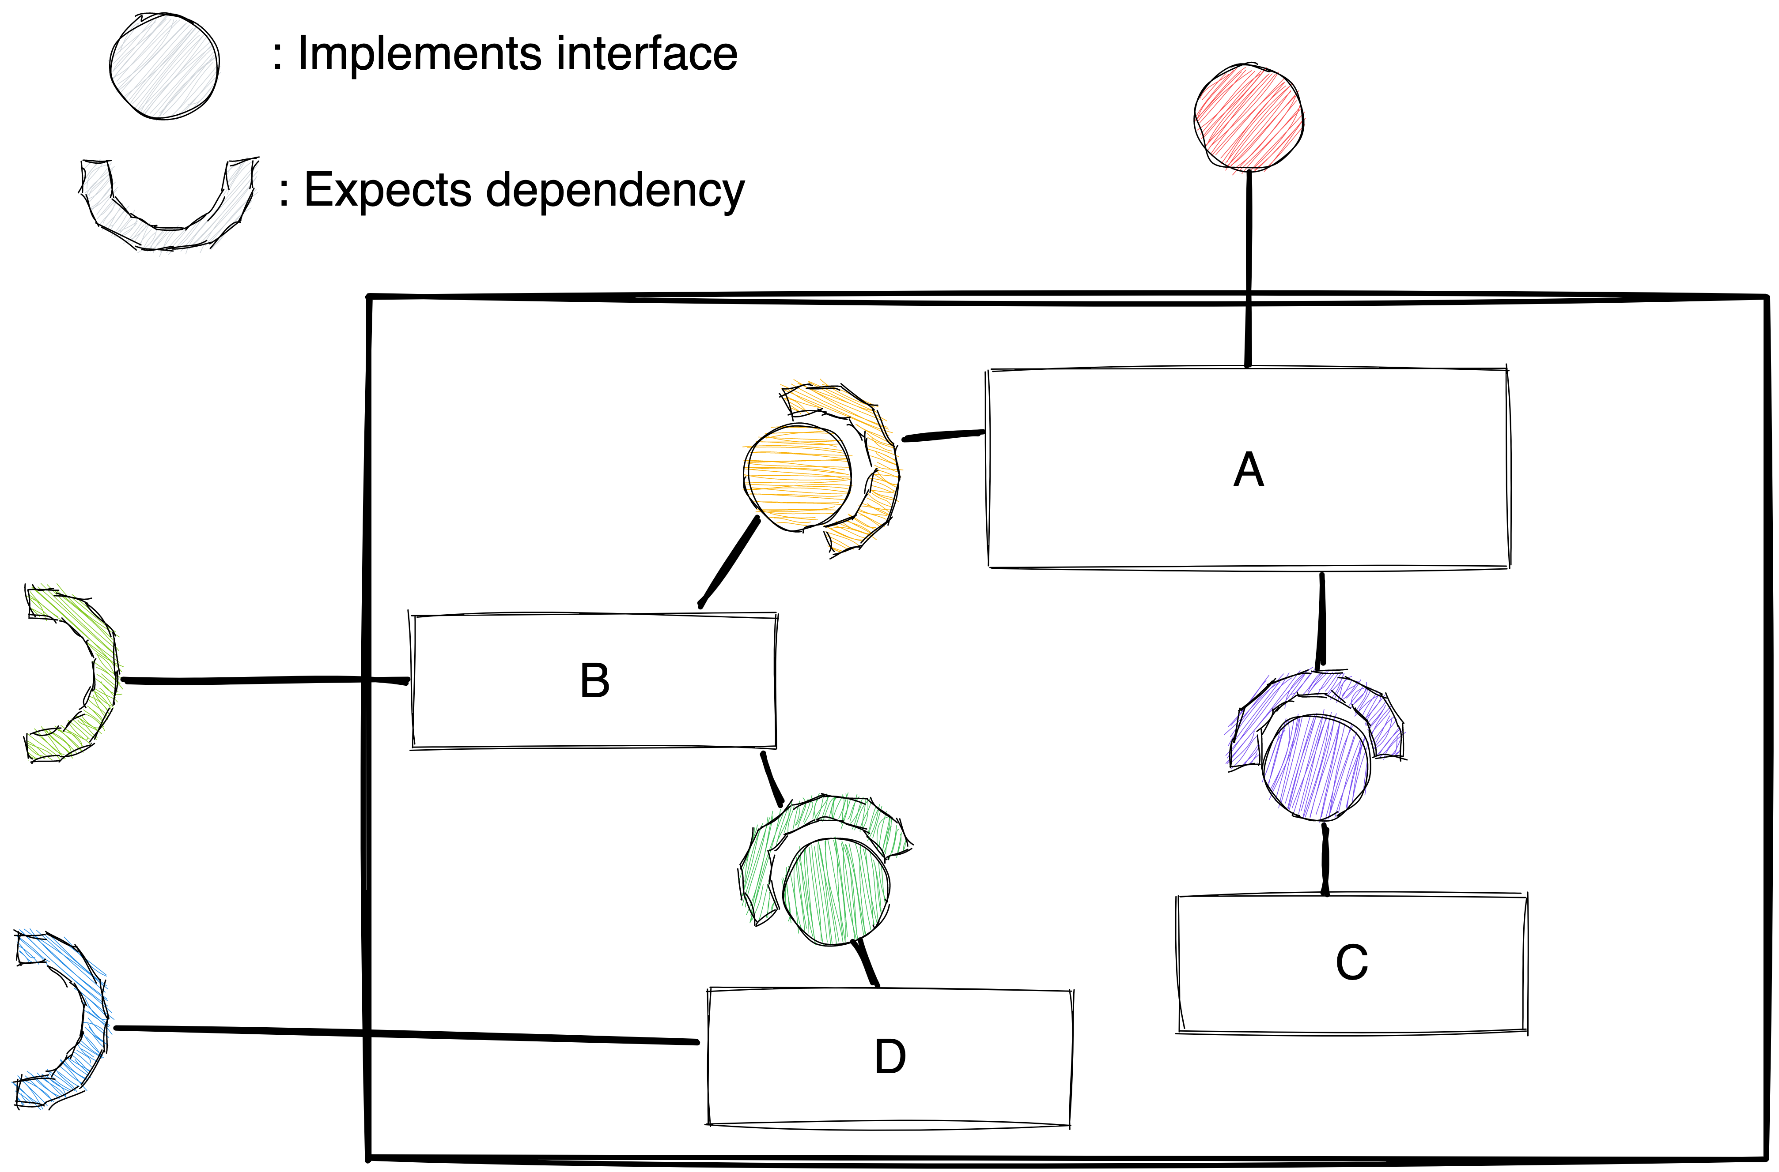
Abstracting Components

Slide 109
Abstracting Components
How to create it?
Factory
Notes:
We saw several ways in which to create components.
A macro component can be just created like any other component.
But we have also another option

Slide 110
Abstracting Components
How to create it?
Factory
Struct
Notes:
For macro-components, we usually don’t need polymorphism: they will always return the same class.
But we want still to force the user to program against the interface.
We can return a struct in that case. Let’s see how

Slide 111
Abstracting Components
auto make_macro_component(IFoo& foo, Ibar& bar) {
struct Holder {
…
};
return Holder(foo, bar);
}
Notes:
We simply define a local struct and return it by value, passing the required interfaces for the component

Slide 112
Abstracting Components
struct Holder {
private:
D d;
C c;
B b;
public:
Holder(Intf2& i1, Intf2& i2)
: d(i1), c(), b(d, i2), a(b, c) {}
A a;
};
Notes:
The struct contains all the concrete types by value, in the private section.
In the public section, you expose the main component. . See this as a more complicated constructor of the component
This requires RVO and copy-elision to take place
Alternatively, expose just a reference to the interface in the public fields, and have the concrete class private.

Slide 113
Abstracting Components
Pros
Can expose multiple interfaces
Automatic lifetime
Cons
No polymorphism
Physical dependency on implementation detail

Slide 114
Abstracting Components
An option for testability
Split complicated implementation detail
Test implementation detail
Expose the component hiding the detail
Notes:
This technique can be useful to improve testability of components as well
Sometimes you have a component which exposes a coherent functionality, but a part deep inside it is quite complicated.
You’d like to test that complicated part in isolation.

Slide 115
Abstracting Components
Enable to compose higher level components
Apply testing facilities to complex functionalities

Slide 116
Optional: bridge classes
Class providing functionality is not an interface, but class requires a dependency
Create a class/function which implements the interface using the component
Shallow classes put complexity in the wiring, which is harder to understand. Avoid small classes

Slide 117
Plea
Plea: avoid overengineering
There is a size of components where it doesn’t make sense to abstract away things
Be careful, the flexibility comes at a cost

Slide 118
Conclusion

Slide 119
Conclusion
We saw
overview of Dependency Injection
define the interfaces to data and behaviors
to pass dependencies to components
to defer decisions with factories
how to expose higher level components
Notes:
To understand a component, you need have to look only at the code and the dependencies’ contract

Slide 120
Conclusion
Tools
to manage complexity
evolve code easily
tradeoff flexibility/understandability
Notes:
These are tools
A fixed component is easier to understand than a parametrized one, but harder to evolve.
Be careful on when to apply these concepts, and make sure the complexity pays for itself.
And with this, I hope you found these concepts useful, and that you’ll be able to apply them to your codebase.

Slide 121
Thank you

Slide 123
Resources
Designing classes: https://www.youtube.com/watch?v=bmSAYlu0NcY&t=754s

